Slide 1
Optimal algorithms for experts and mixtures of Gaussians
Version of August 6, 2020
Chris Liaw
UBC, August 2020
1
Notes:
Thanks everyone for coming. Today, I’d like to tell you about some of the work that I have been doing over the course of my PhD.

Slide 2
Research overview
Goal: Design & analyze machine learning algorithms with provable guarantees.
2
Notes:
Over the course of my PhD, a primary focus for me has been problems which are motivated by machine learning. And I’ve looked at a number of such problems ranging from better understanding gradient descent or neural networks.
For today, I will tell you about two projects which I am particularly proud of.

Slide 3
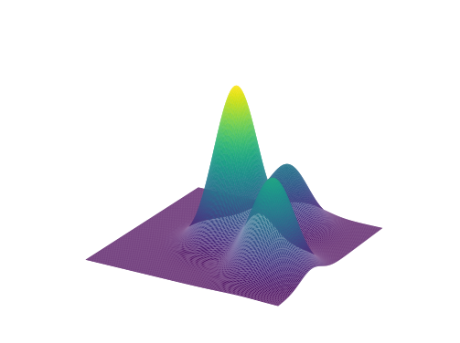
Research overview
Goal: Design & analyze machine learning algorithms with provable guarantees.
Prediction with expert advice
[HLPR, FOCS‘20]
Learning mixtures of Gaussians
[ABHLMP NeurIPS’18, JACM’20]
2
Notes:
In the first half of my talk, I will tell you about the problem of prediction with expert advice. In particular, I will tell you how we used tools from stochastic calculus and PDEs to design the optimal algorithm when there are two experts.
In the second half of my talk, I will talk to you about the problem of learning mixtures of Gaussians. Here I will tell you about a new framework for learning distributions and show how we can apply it to learn mixtures of Gaussian with as few data points as possible.

Slide 4
Part 1. Optimal anytime regret with two experts.
Nicholas J. A. Harvey, Christopher Liaw, Edwin Perkins, Sikander Randhawa. Optimal Anytime Regret with Two Experts. FOCS 2020.
3
Notes:
Okay, let’s start with part 1. This is joint work with my advisor, Nick Harvey, as well as Ed Perkins, and Sikander Randhawa. The paper will also be presented at the FOCS conference later this year.

Slide 5
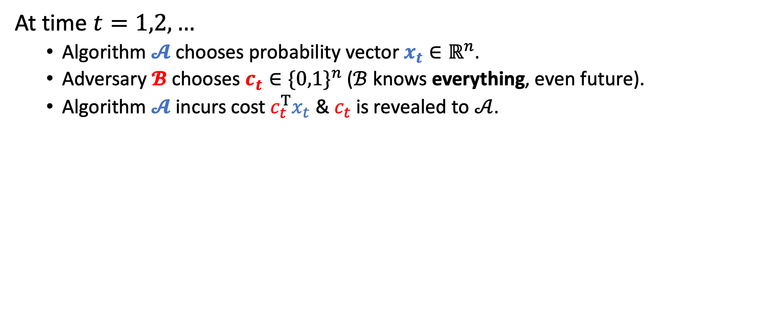
Prediction with expert advice
At time $t=1,2,…$
Algorithm $𝓐$ chooses probability vector $x_{t}∈ℝ^{n}$.
Adversary $𝓑$ chooses $c_{t}∈{\{0,1\}}^{n}$ ($ℬ$ knows everything, even future).
Algorithm $𝓐$ incurs cost $c_{t}^{T}x_{t}$ & $c_{t}$ is revealed to $𝒜$.
4
Notes:
The problem is as follows.
At each time step t, an algorithm chooses a probability vector x_t in R^n.
After that, an adversary chooses a cost vector c_t in R^n which is either 0 or 1. Think of 0 as being that the corresponding expert is correct, so incurs no cost, and that 1 corresponds to the expert being incorrect, so it incurs cost.
Note that I am assuming that the adversary knows everything so it is quite powerful. It knows the adversary’s probability vector and even how it will evolve over time, depending on what the adversary itself is doing.
Finally, with the algorithm having chosen his x_t and the adversary choosing costs, the algorithm incurs cost c_t^T x_t which is the probability of the algorithm being wrong. And then the entire vector c_t is revealed to the algorithm.
The algorithm’s goal is to try to minimize its regret which is defined as follows. The blue component is the expected number of mistakes that the algorithm has made up to time T and the red term is the number of mistakes, or cost, made by the best expert. So then the regret is how many more mistakes the algorithm makes (in expectation) than the best expert.
Last, I want to stress that there isn’t actually any randomness in the problem. Every quantity here is completely deterministic. The vector x_t is deterministic, the adversary’s cost is deterministic, and so on.

Slide 6
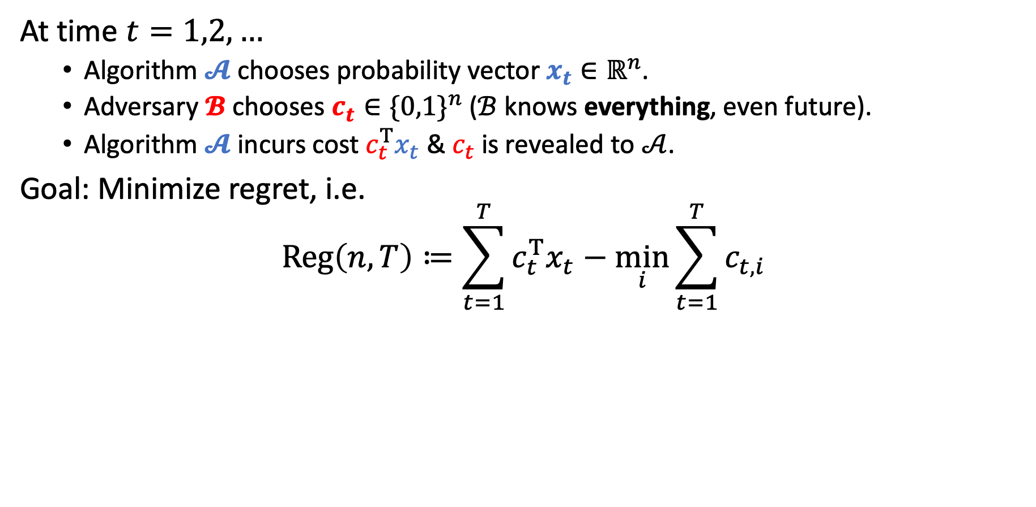
Prediction with expert advice
At time $t=1,2,…$
Algorithm $𝓐$ chooses probability vector $x_{t}∈ℝ^{n}$.
Adversary $𝓑$ chooses $c_{t}∈{\{0,1\}}^{n}$ ($ℬ$ knows everything, even future).
Algorithm $𝓐$ incurs cost $c_{t}^{T}x_{t}$ & $c_{t}$ is revealed to $𝒜$.
Goal: Minimize regret, i.e.
$$Reg\left(n,T\right)≔\sum_{t=1}^{T}{c_{t}^{T}x_{t}}−\min_{i}{\sum_{t=1}^{T}{c_{t,i}}}$$
Algorithm’s cost
Cost of best expert
Note. There is no randomness in the problem.
5
Notes:
The problem is as follows.
At each time step t, an algorithm chooses a probability vector x_t in R^n.
After that, an adversary chooses a cost vector c_t in R^n which is either 0 or 1. Think of 0 as being that the corresponding expert is correct, so incurs no cost, and that 1 corresponds to the expert being incorrect, so it incurs cost.
Note that I am assuming that the adversary knows everything so it is quite powerful. It knows the adversary’s probability vector and even how it will evolve over time, depending on what the adversary itself is doing.
Finally, with the algorithm having chosen his x_t and the adversary choosing costs, the algorithm incurs cost c_t^T x_t which is the probability of the algorithm being wrong. And then the entire vector c_t is revealed to the algorithm.
The algorithm’s goal is to try to minimize its regret which is defined as follows. The blue component is the expected number of mistakes that the algorithm has made up to time T and the red term is the number of mistakes, or cost, made by the best expert. So then the regret is how many more mistakes the algorithm makes (in expectation) than the best expert.
Last, I want to stress that there isn’t actually any randomness in the problem. Every quantity here is completely deterministic. The vector x_t is deterministic, the adversary’s cost is deterministic, and so on.

Slide 7
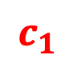
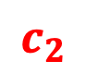
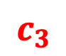
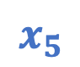
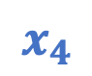



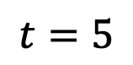
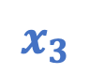
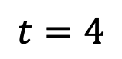
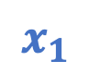
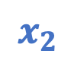
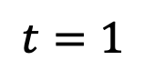
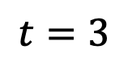
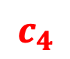
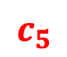
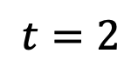

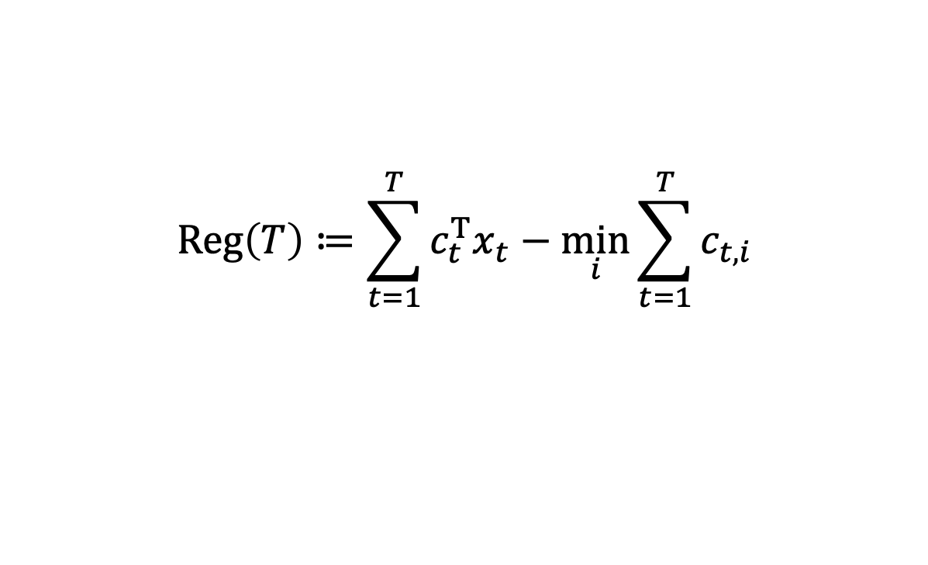



Example
$$Reg\left(T\right)≔\sum_{t=1}^{T}{c_{t}^{T}x_{t}}−\min_{i}{\sum_{t=1}^{T}{c_{t,i}}}$$
Follow best expert?
$$t=1$$
$$t=2$$
$$t=3$$
$$t=4$$
$$t=5$$
$$x_{1}$$
$$c_{1}$$
$$x_{2}$$
$$c_{2}$$
$$x_{3}$$
$$c_{3}$$
$$x_{4}$$
$$c_{4}$$
$$x_{5}$$
$$c_{5}$$
0.5
$$1$$
0.0
$$0$$
0.5
$$0$$
1.0
$$1$$
0.5
$$1$$
0.5
$$0$$
1.0
$$1$$
0.5
$$1$$
0.0
$$0$$
0.5
$$0$$
Algorithm
0.5
1.5
2
3
3.5
Best Expert
0
1
1
2
2
Regret
0.5
0.5
1.0
1.0
1.5
6
Notes:
Let’s do an example of this with two experts. So initially, both experts have cost 0 and are equally good. So you should really place 50/50 since you have no data. So now suppose the top expert is wrong and incurs cost 1 and the bottom is right and incurs no cost. So you incur cost 0.5 and regret is 0.5.
Now a natural thing you might try is to always follow the best expert. So let’s do this. You know place all your trust on the bottom expert. But the adversary knows this and says that that expert is wrong.
Continue example….

Slide 8
Example
$$Reg\left(T\right)≔\sum_{t=1}^{T}{c_{t}^{T}x_{t}}−\min_{i}{\sum_{t=1}^{T}{c_{t,i}}}$$
Follow best expert?
$$t=1$$
$$t=2$$
$$t=3$$
$$t=4$$
$$t=5$$
$$x_{1}$$
$$c_{1}$$
$$x_{2}$$
$$c_{2}$$
$$x_{3}$$
$$c_{3}$$
$$x_{4}$$
$$c_{4}$$
$$x_{5}$$
$$c_{5}$$
0.5
$$1$$
0.0
$$0$$
0.5
$$0$$
1.0
$$1$$
0.5
$$1$$
0.5
$$0$$
1.0
$$1$$
0.5
$$1$$
0.0
$$0$$
0.5
$$0$$
Following best expert can make regret grow linearly.
Algorithm
0.5
1.5
2
3
3.5
Best Expert
0
1
1
2
2
Regret
0.5
0.5
1.0
1.0
1.5
6
Notes:
What I want to observe is that, with this adversary, every time the two experts are the same, the regret increases by ½ and so the regret is linear in the number of time steps.

Slide 9
Example
$$Reg\left(T\right)≔\sum_{t=1}^{T}{c_{t}^{T}x_{t}}−\min_{i}{\sum_{t=1}^{T}{c_{t,i}}}$$
A little hedging…
$$t=1$$
$$t=2$$
$$t=3$$
$$t=4$$
$$t=5$$
$$x_{1}$$
$$c_{1}$$
$$x_{2}$$
$$c_{2}$$
$$x_{3}$$
$$c_{3}$$
$$x_{4}$$
$$c_{4}$$
$$x_{5}$$
$$c_{5}$$
0.5
$$1$$
0.4
$$0$$
0.5
$$0$$
0.6
$$1$$
0.5
$$1$$
0.5
$$0$$
0.6
$$1$$
0.5
$$1$$
0.4
$$0$$
0.5
$$0$$
Algorithm
0.5
1.1
1.6
2.2
2.7
Best Expert
0
1
1
2
2
Regret
0.5
0.1
0.6
0.2
0.7
7
Notes:
Actually, you can do better if you decide to hedge a little bit.
In fact, you can obtain regret that scales as the square root of time and not linearly in time.

Slide 10
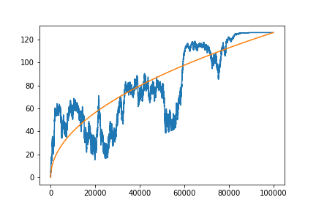
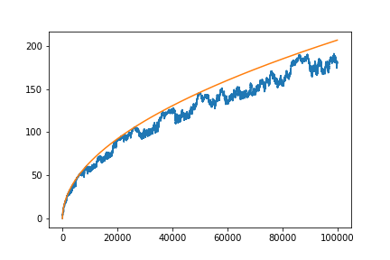

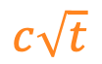

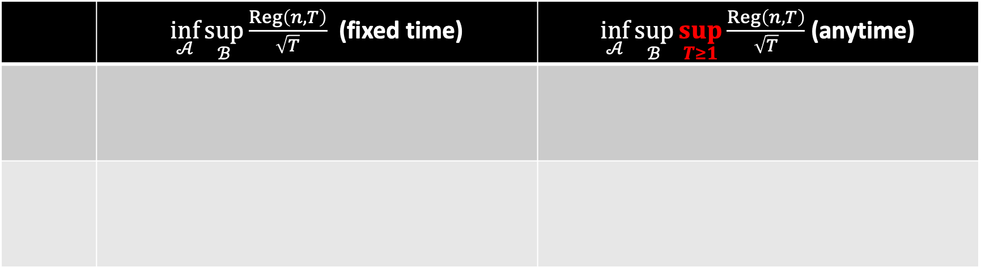
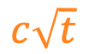
Known results
 | $\inf_{𝒜}{\sup_{ℬ}{\frac{Reg\left(n,T\right)}{\sqrt{T}}}}$ (fixed time) | $\inf_{𝒜}{\sup_{ℬ}{\sup_{T≥1}{\frac{Reg\left(n,T\right)}{\sqrt{T}}}}}$ (anytime)
$$c\sqrt{t}$$
$$c\sqrt{t}$$
$$Reg\left(t\right)$$
$$Reg\left(t\right)$$
8
Notes:
Here’s what is known about the problem.

Slide 11
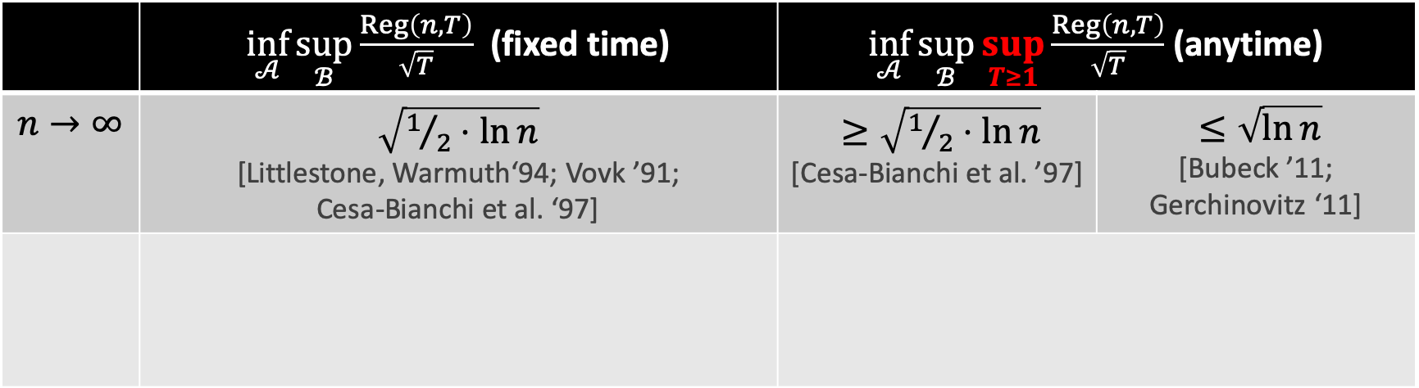
Known results
 | $\inf_{𝒜}{\sup_{ℬ}{\frac{Reg\left(n,T\right)}{\sqrt{T}}}}$ (fixed time) | $\inf_{𝒜}{\sup_{ℬ}{\sup_{T≥1}{\frac{Reg\left(n,T\right)}{\sqrt{T}}}}}$ (anytime)
$$n→∞$$ | $\sqrt{1/2⋅ln{n}}$ [Littlestone, Warmuth‘94; Vovk ’91; Cesa-Bianchi et al. ‘97] | $≥\sqrt{1/2⋅\ln{n}}$ [Cesa-Bianchi et al. ’97] | $≤\sqrt{\ln{n}}$ [Bubeck ’11; Gerchinovitz ‘11]
$$c\sqrt{t}$$
$$c\sqrt{t}$$
$$Reg\left(t\right)$$
$$Reg\left(t\right)$$
8
Notes:
First, I will assume that n is large. There are two common settings to state the results.
The first is the fixed time setting where we assume the algorithm is given some time T in advance and its goal is to minimize regret at time T and only at time T.
Then it’s known that there is an algorithm that gets regret sqrt(1/2 * ln(n) * T).
So looking at the picture, if you draw a square root t curve with the constant c being sqrt(1/2 * ln(n)) then at the last time step, the regret is below the curve but before the last time step, there is no guarantee. And this is true regardless of what the adversary does.
Also the constant here is best possible.
A more stringent setting is the anytime setting where the goal is to control the regret at all points and not just at the last time step.
So we can still get it below the square root t curve but with a slightly larger constant of sqrt(ln(n)).
However, for the any time setting, we don’t know if this constant is tight so there could be a better algorithm.

Slide 12
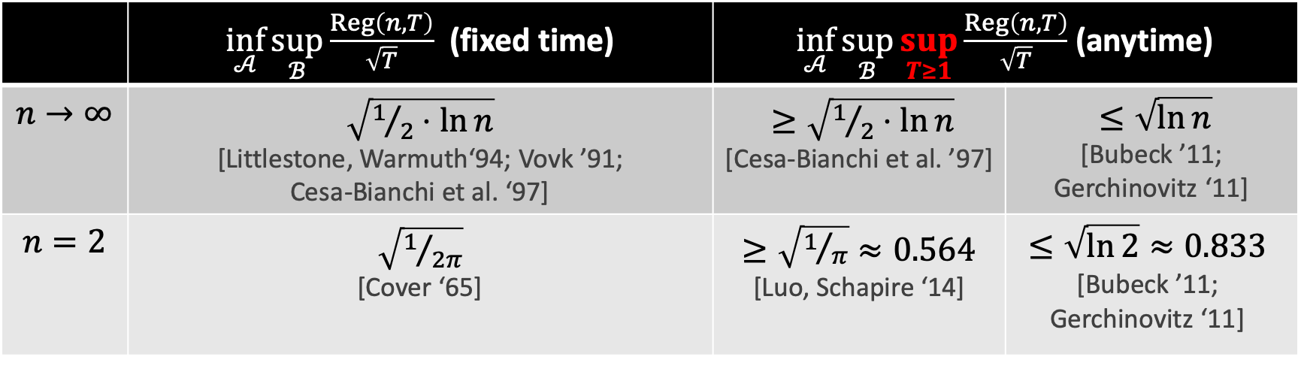
Known results
 | $\inf_{𝒜}{\sup_{ℬ}{\frac{Reg\left(n,T\right)}{\sqrt{T}}}}$ (fixed time) | $\inf_{𝒜}{\sup_{ℬ}{\sup_{T≥1}{\frac{Reg\left(n,T\right)}{\sqrt{T}}}}}$ (anytime)
$$n→∞$$ | $\sqrt{1/2⋅ln{n}}$ [Littlestone, Warmuth‘94; Vovk ’91; Cesa-Bianchi et al. ‘97] | $≥\sqrt{1/2⋅\ln{n}}$ [Cesa-Bianchi et al. ’97] | $≤\sqrt{\ln{n}}$ [Bubeck ’11; Gerchinovitz ‘11]
$$n=2$$ | $\sqrt{1/{2π}}$ [Cover ‘65] | $≥\sqrt{1/π}≈0.564$ [Luo, Schapire ‘14] | $$≤\sqrt{\ln{2}}≈0.833$$ [Bubeck ’11; Gerchinovitz ‘11]
$$c\sqrt{t}$$
$$c\sqrt{t}$$
$$Reg\left(t\right)$$
$$Reg\left(t\right)$$
8
Notes:
The problem is also interesting when there are a small number of experts.
For n = 2, Thomas Cover showed that you can regret sqrt(T/2*pi) and that this is tight.
For the anytime setting, there is again a gap.
You can’t hope to get regret smaller than sqrt(t/pi) for all time steps but there is an algorithm that will have regret sqrt(t*ln 2) for all time steps. So perhaps there is better algorithm or better lower bound.

Slide 13
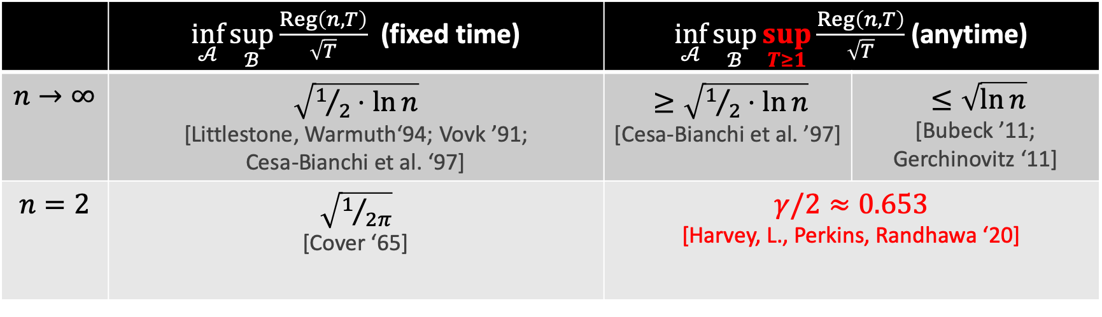
Known results
 | $\inf_{𝒜}{\sup_{ℬ}{\frac{Reg\left(n,T\right)}{\sqrt{T}}}}$ (fixed time) | $\inf_{𝒜}{\sup_{ℬ}{\sup_{T≥1}{\frac{Reg\left(n,T\right)}{\sqrt{T}}}}}$ (anytime)
$$n→∞$$ | $\sqrt{1/2⋅ln{n}}$ [Littlestone, Warmuth‘94; Vovk ’91; Cesa-Bianchi et al. ‘97] | $≥\sqrt{1/2⋅\ln{n}}$ [Cesa-Bianchi et al. ’97] | $≤\sqrt{\ln{n}}$ [Bubeck ’11; Gerchinovitz ‘11]
$$n=2$$ | $\sqrt{1/{2π}}$ [Cover ‘65] | $γ/2≈0.653$ [Harvey, L., Perkins, Randhawa ‘20]
$$c\sqrt{t}$$
$$c\sqrt{t}$$
$$Reg\left(t\right)$$
$$Reg\left(t\right)$$
8
Notes:
Our main result is both. We give a better algorithm and an improved lower bound.
We show that the optimal constant is gamma / 2 where gamma is a constant that I will explain on the next slide.
I want to stress that the point is not necessarily to just get better constants.
Really, we want to better understand what are some of the fundamental ideas that underlie the optimal algorithms and the optimal regret.
In fact, all the tight results are naturally related to random walks.
In the fixed time setting, the quantities are related to random walks of a fixed length.
The constant gamma for our result is actually related to random walks hitting a certain boundary similar to the picture I drew.
Maybe you can hint towards the big picture on slide 14 too: the goal is not really to say that 0.65 is better than 0.83, the goal is to understand the fundamental ideas that underlie the optimal numbers. With Cover, the optimal number comes from properties of random walks of length T. With us, the optimal number also comes from random walks / Brownian motion, but uncovering that number is a bit more complicated because you have to solve a stochastic calculus problem.

Slide 14
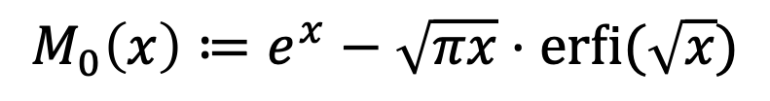
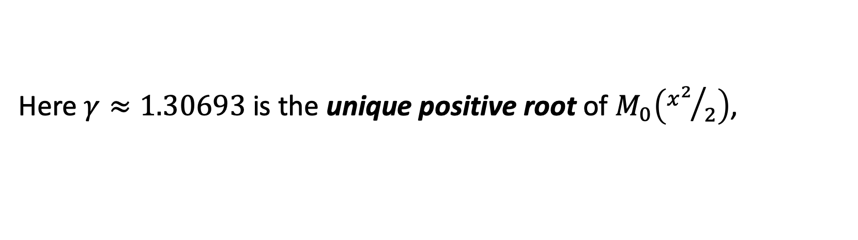
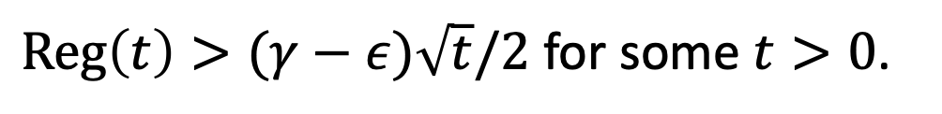
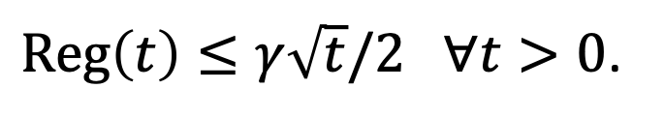
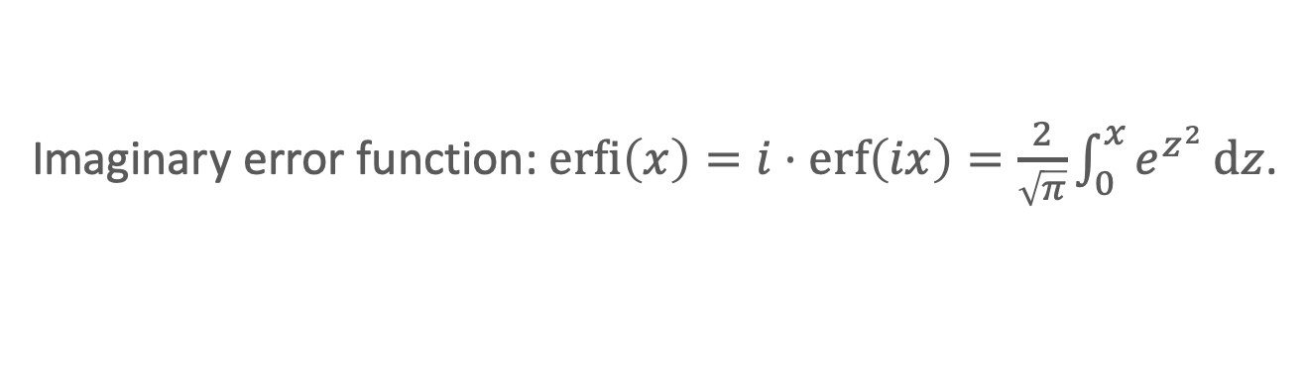
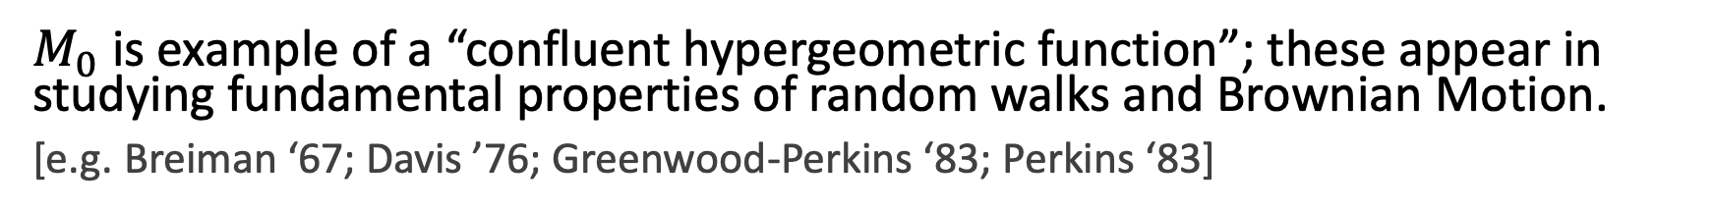
Our result
Imaginary error function: $\operatorname{erfi}\left(x\right)=i⋅erf\left(ix\right)=\frac{2}{\sqrt{π}}\int_{0}^{x}{e^{z^{2}}}dz$.
Theorem [HLPR ‘20]
For $n=2$ experts, there is an alg. that guarantees (against all adversaries)
$Reg\left(t\right)≤γ\sqrt{t}/2 ∀t>0$.
Moreover, for any algorithm and $ε>0$, there is adversary that forces
$Reg\left(t\right)>(γ−ε)\sqrt{t}/2$ for some $t>0$.
Here $γ≈1.30693$ is the unique positive root of $M_{0}\left({x^{2}}/2\right)$,
$$M_{0}\left(x\right)≔e^{x}−\sqrt{πx}⋅\operatorname{erfi}{(\sqrt{x}})$$
$M_{0}$ is example of a “confluent hypergeometric function”; these appear in studying fundamental properties of random walks and Brownian Motion.
[e.g. Breiman ‘67; Davis ’76; Greenwood-Perkins ‘83; Perkins ‘83]
Next: Discuss use of stochastic calculus & PDEs to design optimal algorithm.
9
Notes:
So our main result is as follows.
For n = 2, there is an algorithm whose regret at time t is bounded above by gamma * sqrt(t) / 2.
This is true for all time t and regardless of what the adversary does.
Here, gamma is defined as the unique positive root of the function M_0(x^2/2) where M_0 is given by this formula.
I’ll say a little bit more about this function in a bit.
This constant is also tight in the following sense.
For any positive epsilon and any algorithm, there is something that the adversary can do to force regret at least (gamma – epsilon)*sqrt(t)/2 for some time t.
So a little bit about the function M0.
Initially it looks a bit bizarre and in fact, we initially thought there was no way this could have been correct.
But in hindsight, the function is a lot more natural.
It’s an example of a confluent hypergeometric function and these functions crop up all the time when studying properties of random walks and Brownian Motion.
Next, we will talk about how to design the algorithm. What I think is really interesting is that despite the problem being a very combinatorial and discrete problem, our design will utilize tools from continuous-time stochastic calculus and PDEs.

Slide 15
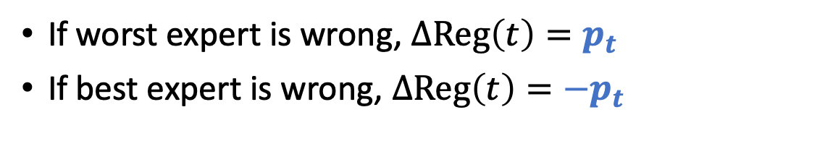
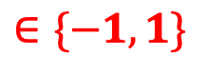
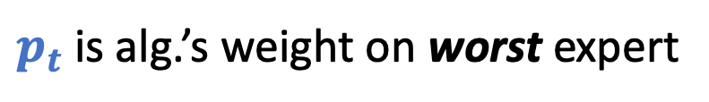
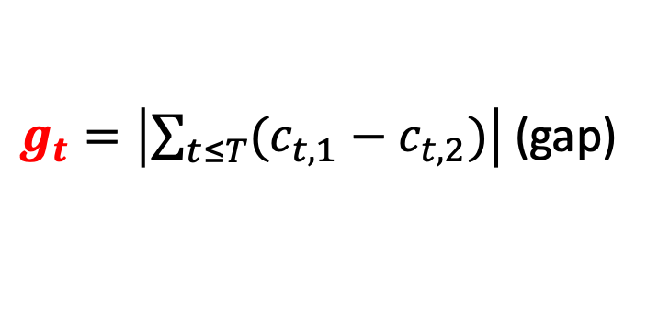
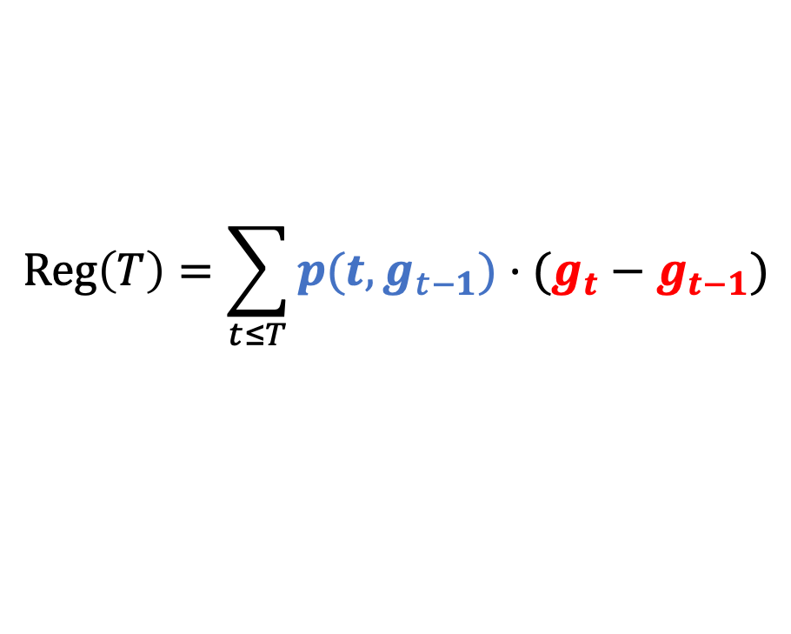
Regret as a stochastic integral
Discrete regret for two experts.
$$Reg\left(T\right)=\sum_{t≤T}{p(t,g_{t−1})⋅(g_{t}−g_{t−1})}$$
$g_{t}=\left|\sum_{t≤T}{(c_{t,1}−c_{t,2})}\right|$ (gap)
$$∈\{−1,1\}$$
$p_{t}$ is alg.’s weight on worst expert
If worst expert is wrong, $ΔReg\left(t\right)=p_{t}$
If best expert is wrong, $ΔReg\left(t\right)={−p}_{t}$
10
Notes:
First, I’d like to make a simple observation which you can get by a short calculation.
Let’s look at the gap between the two experts so g_t here is the number of mistakes made by the worst expert minus the number of mistakes made by the best expert.
And also let p be the weight we put on the worst expert so 1-p is the weight we up on the best expert.
Now, the formula is saying that the change in regret at time t goes up by p if the worst expert is wrong and the best expert is right.
And the change in regret goes down by p if the best expert is wrong and the worst expert is correct.
There’s also the possibility that both experts are correct or both are wrong but those turn to be bad decisions for the adversary.
Our goal then is to design p(t,g) so that the Reg is small and it should be small regardless of what the sequence of gaps is.

Slide 16

Regret as a stochastic integral
Discrete regret for two experts.
$$Reg\left(T\right)=\sum_{t≤T}{p(t,g_{t−1})⋅(g_{t}−g_{t−1})}$$
$g_{t}=\left|\sum_{t≤T}{(c_{t,1}−c_{t,2})}\right|$ (gap)
$$∈\{−1,1\}$$
$p_{t}$ is alg.’s weight on worst expert
Idea. View $g_{t}$ as reflected random walk. Goal. Control $Reg\left(T\right)$ a.s.
Alg/Adv play at discrete times.
10
Notes:
I want to take a viewpoint which really doesn’t change anything.
Let’s imagine that the adversary just flips a coin and each time step to choose which expert will be wrong.
This turns out to mean that the gap evolves as a reflected random walk. In other words, it’s a normal random walk
Except when it is at 0, it goes up by 1 deterministically.
And now we want to design p(t,g) so that the regret is almost surely bounded.
This sounds like there’s nothing different since it’s the same as bounding regret for all sequences of gaps.
But actually, it becomes quite natural to consider a natural continuous analogue.

Slide 17
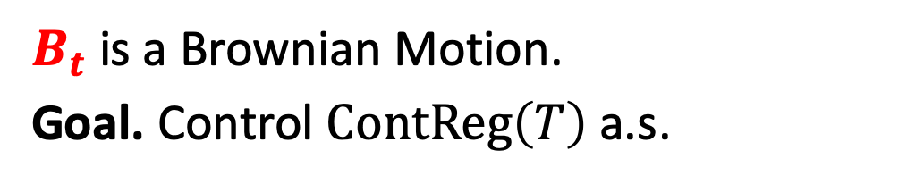
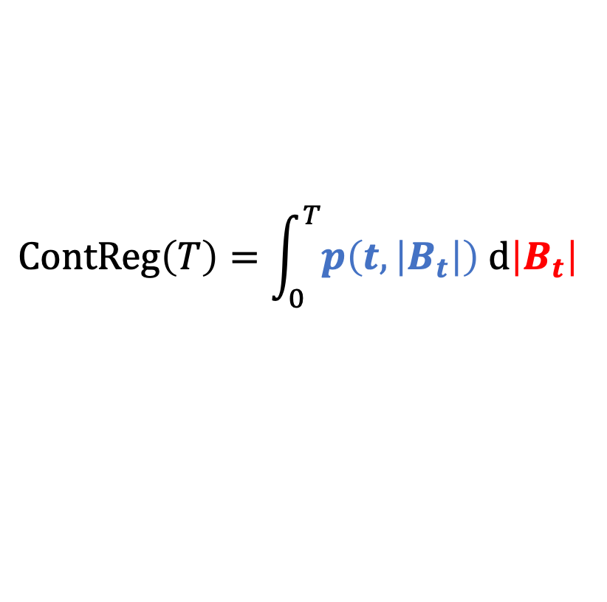
Regret as a stochastic integral
Discrete regret for two experts.
Continuous regret for two experts.
$$Reg\left(T\right)=\sum_{t≤T}{p(t,g_{t−1})⋅(g_{t}−g_{t−1})}$$
$$ContReg\left(T\right)=\int_{0}^{T}{p\left(t,\left|B_{t}\right|\right) d\left|B_{t}\right| }$$
Idea. View $g_{t}$ as reflected random walk. Goal. Control $Reg\left(T\right)$ a.s.
$B_{t}$ is a Brownian Motion.
Goal. Control $ContReg\left(T\right)$ a.s.
Alg/Adv play at discrete times.
Alg/Adv play continuously.
10
Notes:
So instead of evolving the gap as a reflected random walk, we will evolve the gap as a reflected Brownian Motion.
So this is just the absolute value of Brownian Motion.
This gives rise to the notion of continuous regret which is the stochastic integral of our strategy w.r.t. reflected Brownian Motion.
Again, our goal is to obtain an almost sure bound on the regret.
Except now that we are working in continuous-time, we will have access to some clean and elegant tools.

Slide 18
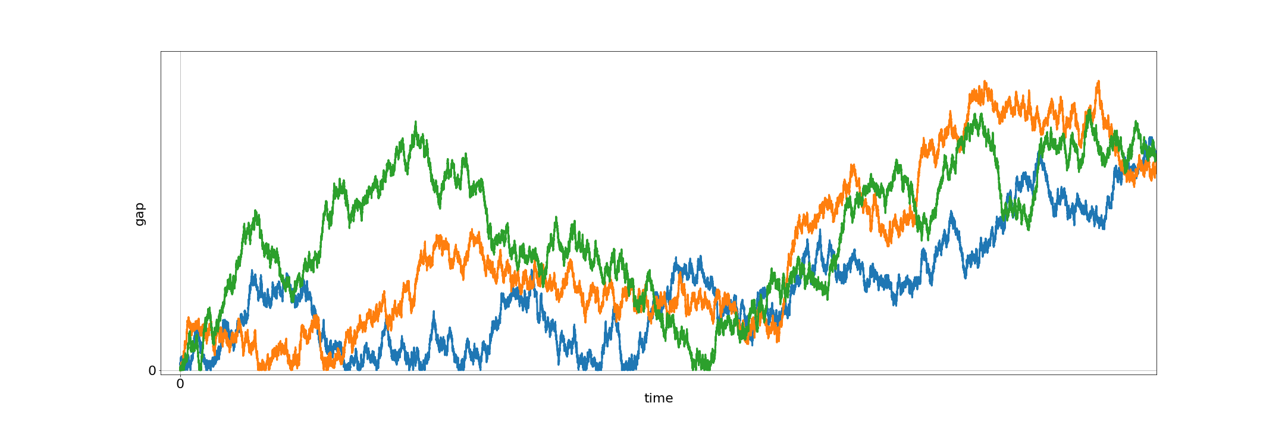
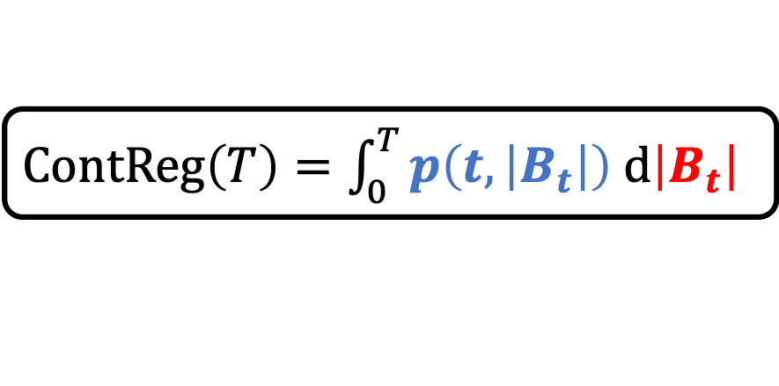
Designing the algorithm
$ContReg\left(T\right)=\int_{0}^{T}{p\left(t,\left|B_{t}\right|\right) d\left|B_{t}\right| }$
Kiyoshi Itô
Key Idea. Design $p$ so that all paths w/ common endpoints have equal regret.
$$ContReg\left(T\right)≠ContReg\left(T\right)≠ContReg(T)$$
11
Notes:
Okay, so we have the continuous regret and its definition.
One thing I want to point out is that that the regret is inherently a pathwise quantity.
In other words, the adversary has many potential ways to evolve the gap.
For example, the gap could evolve as the green path or this orange path or this blue path.
And in each of these, the regret may be potentially different even though they end at the same point.
A key turns out to be to design p so that the regret is the same for all of these paths.
In other words, the algorithm is designed to be as balanced of an algorithm as possible.

Slide 19
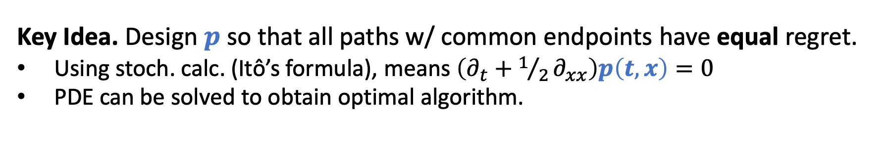
Designing the algorithm
$ContReg\left(T\right)=\int_{0}^{T}{p\left(t,\left|B_{t}\right|\right) d\left|B_{t}\right| }$
Kiyoshi Itô
Key Idea. Design $p$ so that all paths w/ common endpoints have equal regret.
Using stoch. calc. (Itô’s formula), means $\left(∂_{t}+1/2∂_{xx}\right)p\left(t,x\right)=0$
PDE can be solved to obtain optimal algorithm.
Miracle. Arguments can be discretized with no loss.
$$ContReg\left(T\right)=ContReg\left(T\right)=ContReg(T)$$
11
Notes:
Using a key tool from stochastic calculus, namely Ito’s formula, it turns out this wanting a balanced algorithm is equivalent to this PDE where we want partial_t + ½ *partial_xx of p is equal to 0.
This is a well-studied PDE known as the backwards heat equation.
Now, designing the algorithm just comes down to solving the backwards heat equation and this we can do to obtain the optimal algorithm.
In fact, the entire argument can be discretized and we lose nothing in the regret, which I think is quite miraculous.
So that’s all I want to say about how we design the algorithm

Slide 20
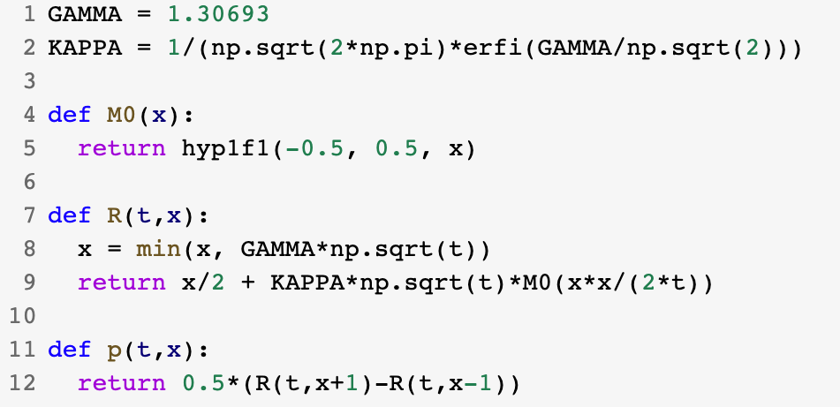
Python implementation
12
Notes:
Last, I want to say that when all is said and done, the algorithm that we get turns out to be dead simple.
Turns out that confluent hypergeometric functions are standard in Python and, after you defined some functions, it only takes a line of Python code to define the algorithm.

Slide 21
Part 2. Sample-optimal algorithms for learning mixtures of Gaussians.
Hassan Ashtiani, Shai Ben-David, Nicholas J. A. Harvey, Christopher Liaw, Abbas Mehrabian, Yaniv Plan. Near-optimal Sample Complexity Bounds for Robust Learning of Gaussian Mixtures via Compression Schemes. Journal of the ACM. 2020.
13
Notes:
I’d like to now talk move to part 2 of my talk. And this is on sample-optimal algorithms for learning mixtures of Gaussians.
This is joint work with Hassan Ashtiani, Shai Ben-David, Nick Harvey, Abbas Mehrabian, and Yaniv Plan.
We presented it at NeurIPS in 2018 and it’s been accepted to the journal of the ACM.
Some other random stuff:
Local Maxima in the Likelihood of Gaussian Mixture Models: Structural Results and Algorithmic Consequences [https://arxiv.org/pdf/1609.00978.pdf]
Show that the log-likelihood objective may have really bad local optima so one has to be very careful with the initialization
The EM Algorithm gives Sample-Optimality for Learning Mixtures of Well-Separated Gaussians [http://proceedings.mlr.press/v125/kwon20a/kwon20a.pdf]
EM is sample-optimal provided that one has good initialization (I think)

Slide 22

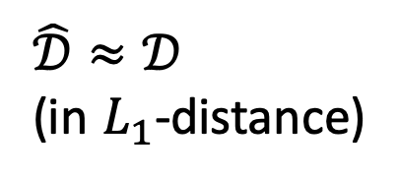
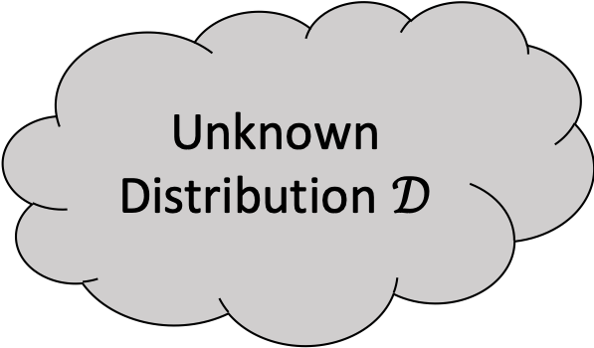
Density estimation
Unknown Distribution $𝒟$
i.i.d. samples
$$\hat{𝒟}≈𝒟$$
(in $L_{1}$-distance)
14
Notes:
In this work, we consider the problem of density estimation which is as follows. There is an unknown distribution D which we are trying to learn and we are allowed to draw iid samples from this distribution. Our goal is to design an algorithm that takes these samples as input and outputs a distribution D hat which is close to D, say in the L1 distance.

Slide 23
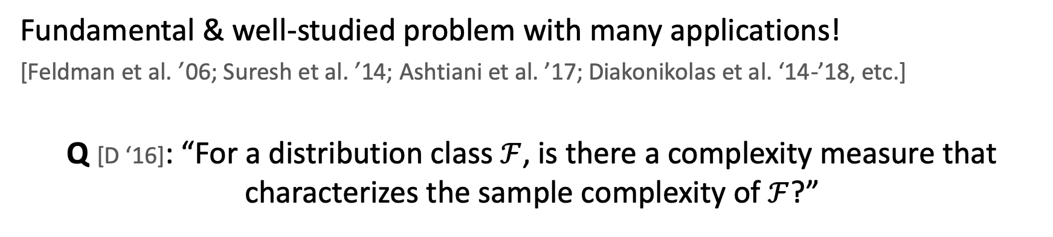
Density estimation
Unknown Distribution $𝒟$
i.i.d. samples
$$\hat{𝒟}≈𝒟$$
(in $L_{1}$-distance)
Fundamental & well-studied problem with many applications!
[Feldman et al. ’06; Suresh et al. ’14; Ashtiani et al. ’17; Diakonikolas et al. ‘14-’18, etc.]
Q [D ‘16]: “For a distribution class $ℱ$, is there a complexity measure that characterizes the sample complexity of $ℱ$?”
14
Notes:
This is a very classical problem and has been studied for well over a century.
One of the most fundamental questions, regarding density estimation, is how many samples are needed from the distribution in order to get a good approximation its density. This is especially important when drawing samples from the unknown distribution is expensive, for example it may require sequencing a person’s genome to get a single sample. In fact, Diakonikolas posed an open problem to better understand the sample complexity of density estimation. More specifically, he asked whether there is some notion of complexity which will completely the characterize the sample complexity for various classes of distributions.
Currently, there is a growing body of work which aims to study the exact sample complexity of some specific classes. In this work, we will look at a very fundamental one, which is mixtures of Gaussians.

Slide 24
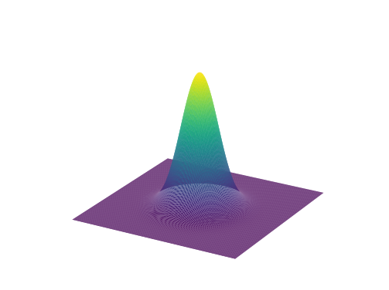
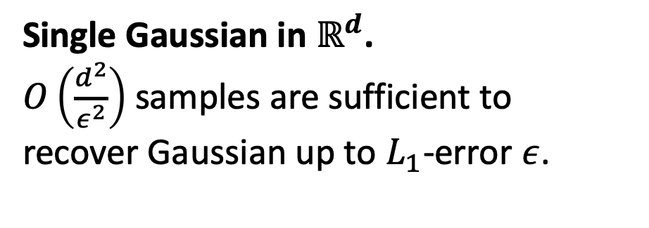
Learning Gaussians
Single Gaussian in $ℝ^{d}$.
$O\left(\frac{d^{2}}{ε^{2}}\right)$ samples are sufficient to
recover Gaussian up to $L_{1}$-error $ε$.
15
Notes:
So let's start off with the simplest setting which is just a single Gaussian in d dimensions.
Here, there is a very simple algorithm to estimate the density.
Given some error parameter eps, we can obtain d^2 / eps^2 samples from the distribution and then compute the sample mean and the sample covariance matrix. This is guaranteed to recover a good approximation to the Gaussian with high probability.
Actually, the bound is very intuitive as a Gaussian has d^2 parameters and one needs something like a 1/eps^2 to account for the sampling error. So the sample complexity for learning a Gaussian is upper bounded by the number of parameters that it has.

Slide 25
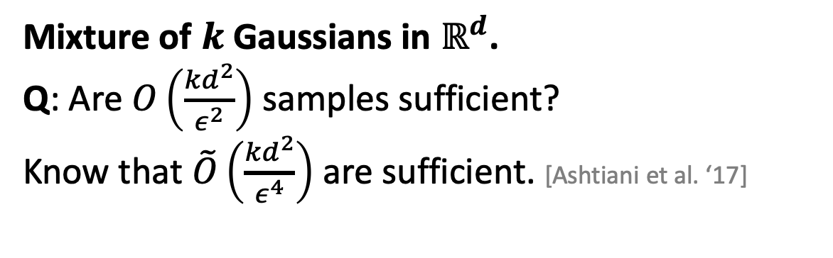
Learning Gaussians
Single Gaussian in $ℝ^{d}$.
$O\left(\frac{d^{2}}{ε^{2}}\right)$ samples are sufficient to
recover Gaussian up to $L_{1}$-error $ε$.
Mixture of $k$ Gaussians in $ℝ^{d}$.
Q: Are $O\left(\frac{{kd}^{2}}{ε^{2}}\right)$ samples sufficient?
Know that $\tilde{O}\left(\frac{{kd}^{2}}{ε^{4}}\right)$ are sufficient. [Ashtiani et al. ‘17]
Note: We aim to recover density, not parameters of the mixture.
15
Notes:
Now what about mixtures of k Gaussians? Here, there are kd^2 parameters so if you were to guess the number of samples that are sufficient then you might guess that kd^2 / epsilon^2 samples should suffice to learn the density. Prior to our work, this question has remained unresolved and is a question that we address in our work. However, previous work of some of my coauthors got close to this bound but with a suboptimal dependence on epsilon.

Slide 26
Main contribution
“Other things being equal, simpler explanations are generally better…” [William of Ockham]
One manifestation of this in learning theory is “sample compression”.
[e.g. Littlestone, Warmuth ‘86; Moran, Yehudayoff ‘16]
16
Notes:
Motivated by the gap in our understanding for learning mixtures of Gaussian, our main contribution in this work is to introduce a new tool for density estimation. One of the philosophical inspirations for this tool is the idea of Occam's razor. That is, all else being equal, if there are multiple explanations for some phenomenon, one ought to go with the explanation that is simpler or that is shorter.
This ideology has had many manifestations in learning theory and one such example is the notion of sample compression introduced by Littlestone and Warmuth for classification theory.

Slide 27
Main contribution
“Other things being equal, simpler explanations are generally better…” [William of Ockham]
One manifestation of this in learning theory is “sample compression”.
[e.g. Littlestone, Warmuth ‘86; Moran, Yehudayoff ‘16]
We introduce a simple & sample-efficient technique for density estimation via compression schemes.
16
Notes:
In this work, we introduce a new notion of compression that is tailored for density estimation. We then use compression to obtain framework for density estimation that is simple to use can can be quite sample-efficient as well.

Slide 28


Main contribution
“Other things being equal, simpler explanations are generally better…” [William of Ockham]
One manifestation of this in learning theory is “sample compression”.
[e.g. Littlestone, Warmuth ‘86; Moran, Yehudayoff ‘16]
We introduce a simple & sample-efficient technique for density estimation via compression schemes.
Application: $\tilde{O}\left({kd}^{2}/ε^{2}\right)$ samples to learn mixtures of $k$ Gaussians in $ℝ^{d}$.
We also show nearly-matching lower bound of $\tilde{Ω}\left({kd}^{2}/ε^{2}\right)$.
*Note: $\tilde{O}$ and $\tilde{Ω}$ hide $polylog(kd/ε)$ factors.
16
Notes:
The main application of this framework is an improved sample complexity upper bound for learning mixtures of k Gaussians in d dimensions. In fact, using this technique allowed us to show that kd^2 / epsilon^2 samples suffice to learn the density up to some small error. We also complement this with a nearly-matching lower bound. Just a reminder, the tilde on top of the Os and Omegas hides polylog(kd/eps) factors.

Slide 29




Compression Gaussians in $ℝ$
$$𝒩\left(μ, σ^{2}\right)$$
$$μ−σ$$
$$μ$$
$$μ+σ$$
17
Notes:
Let’s talk about compression and let’s start with an example. Here I have a Gaussian distribution with an unknown mean mu and unknown variance sigma squared. In the compression framework, we first begin by drawing a small number of points.

Slide 30
Compression Gaussians in $ℝ$
$$𝒩\left(μ, σ^{2}\right)$$
$$μ−σ$$
$$μ$$
$$μ+σ$$
17
Notes:
Once we draw a small number of points, the goal of compression is to try to encode the distribution with as few of these samples as possible.

Slide 31





Compression Gaussians in $ℝ$
$$𝒩\left(μ, σ^{2}\right)$$
$$X_{1}$$
$$X_{2}$$
$$μ−σ$$
$$μ$$
$$μ+σ$$
$$\frac{X_{2}+X_{1}}{2}≈μ$$
$$\frac{X_{2}−X_{1}}{2}≈σ$$
Two samples are sufficient to encode $𝒩\left(μ, σ^{2}\right)$.
17
Notes:
Here is one possibility. We can observe that given a moderate number of samples, there will be a point that is really close to mu – sigma and a point that is close to mu + sigma. So if we single out these two points, the observation is that the mean of these two points is approximately equal to the mean of the Gaussian. Moreover the distance between those points divided by 2 is approximately equal to the standard deviation.
So once you draw a modest number of samples from the true distribution then only two points are required to encode the actual distribution.

Slide 32






Compression framework
$ℱ$: a class of densities (e.g. Gaussians)
$m$ i.i.d. samples
from $f∈ℱ$
$t$ points
reconstruct
$$\hat{f}≈f$$
Knows $f$, $ℱ$
Knows $ℱ$
If Alice draws $m$ samples, sends $t$ points,
and $d_{TV}\left(f,\hat{f}\right)<ε$ then $ℱ$ admits $t$-compression.
18
Notes:
Now, the more general compression framework is as follows. We first fix a class F of distributions. For example this could be the class of Gaussian distributions or the class of mixtures of k Gaussians. Alice knows F and has a distribution D in mind. Bob only knows F. The goal here is for Alice to communicate D to Bob but she has to communicate in a special form which is tailored to work for density estimation.
So, in the compression scheme, Alice is allowed to first draw points from the distribution. She then needs to find a small set of representative points that she could send to Bob.
Next, Bob gets these points that Alice sends to him and he constructs a distribution D hat. Now, if Alice sends t points and Bob’s algorithm is designed so that he has always outputs a distribution that is close to Alice’s distribution then we say that the class F has a compression of size t. In our Gaussian example, we would say that Gaussians have a compression of size 2.

Slide 33

Compression framework
$ℱ$: a class of densities (e.g. Gaussians)
$m$ i.i.d. samples
from $f∈ℱ$
$t$ points
reconstruct
$$\hat{f}≈f$$
Knows $f$, $ℱ$
Knows $ℱ$
If Alice draws $m$ samples, sends $t$ points,
and $d_{TV}\left(f,\hat{f}\right)<ε$ then $ℱ$ admits $t$-compression.
18

Slide 34


Compression Theorem
Theorem [ABHLMP ‘18]
If $ℱ$ has a compression scheme of size $t$ then sample complexity to learn $ℱ$ (up to $L_{1}$-error $ε$) is
$$\tilde{O}\left(\frac{t}{ε^{2}}\right).$$
$\tilde{O}\left(∙\right)$ hides polylog factors
Small compression schemes imply
sample-efficient algorithms.
19
Notes:
One of the key results in our paper is the connection between compression and learnability in the density estimation setting.
What we show is that if you can design a compression scheme for the class F of size t then there is a black box that will take that compression scheme and output a density estimation algorithm that learns any distribution in F with sample complexity only t / epsilon^2 hiding some polylogarithmic factors.
To summarize, short explanations are good because they automatically give sample efficient algorithms.

Slide 35



Compression of mixtures
Cheat: assume a uniform mixture.
$$𝒩\left(μ_{3}, σ_{3}^{2}\right)$$
$$𝒩\left(μ_{1}, σ_{1}^{2}\right)$$
$$𝒩\left(μ_{2}, σ_{2}^{2}\right)$$
20
Notes:
One of the key advantages of compression schemes is that it easily extends to mixture distributions.
So let’s do another example to see this! Suppose that we want to compress a mixture of the three Gaussians illustrated on the slide.
Note the Gaussians could all have potentially different means and variances.
Also for simplicity let’s just assume that we have a uniform distribution over these three Gaussians so a third, a third, a third.

Slide 36
Compression of mixtures
Cheat: assume a uniform mixture.
$$𝒩\left(μ_{3}, σ_{3}^{2}\right)$$
$$𝒩\left(μ_{1}, σ_{1}^{2}\right)$$
$$𝒩\left(μ_{2}, σ_{2}^{2}\right)$$
20
Notes:
In the compression framework, we begin by drawing some samples.
Again, the goal is to find a way to use only a small subset of these points so that one can recover each of these Gaussian distributions.

Slide 37









Compression of mixtures
Cheat: assume a uniform mixture.
$$𝒩\left(μ_{3}, σ_{3}^{2}\right)$$
$$𝒩\left(μ_{1}, σ_{1}^{2}\right)$$
$$𝒩\left(μ_{2}, σ_{2}^{2}\right)$$
$$X_{1}$$
$$X_{2}$$
$$X_{3}$$
$$X_{4}$$
$$X_{5}$$
$$X_{6}$$
$$X_{1}≈μ_{1}−σ_{1}$$
$$X_{2}≈μ_{1}+σ_{1}$$
$$X_{3}≈μ_{2}−σ_{2}$$
$$X_{4}≈μ_{2}+σ_{2}$$
$$X_{5}≈μ_{3}−σ_{3}$$
$$X_{6}≈μ_{3}+σ_{3}$$
20
Notes:
The idea for compression of mixtures is to use the compression scheme that we have for each component and compress each component separately. So to encode the blue Gaussian, we can reuse the two-point compression that we discussed earlier and obtain estimate of the mean and the variance. Similarly, we can use two points to compress the green Gaussian and the red Gaussians. This gives a compression of size 6.

Slide 38

Compression of mixtures
Cheat: assume a uniform mixture.
$$𝒩\left(μ_{3}, σ_{3}^{2}\right)$$
$$𝒩\left(μ_{1}, σ_{1}^{2}\right)$$
$$𝒩\left(μ_{2}, σ_{2}^{2}\right)$$
$$X_{1}$$
$$X_{2}$$
$$X_{3}$$
$$X_{4}$$
$$X_{5}$$
$$X_{6}$$
If $ℱ$ has $t$-compression then
$k$ mixtures of $ℱ$ have $\sim kt\text{−}\text{compression}$.
20
Notes:
More generally, we show that if a class F has a compression of size t then we can compress k mixtures of F with a compression of size roughly kt even without the assumption on the uniform mixture.

Slide 39

Compression Theorem for mixtures
Theorem [ABHLMP ‘18]
If $ℱ$ has a compression scheme of size $t$ then sample complexity to learn $k$ mixtures of $ℱ$ (up to $L_{1}$-error $ε$) is
$$\tilde{O}\left(\frac{kt}{ε^{2}}\right).$$
$\tilde{O}\left(∙\right)$ hides polylog factors
Small compression schemes imply
sample-efficient algorithms for mixtures.
21
Notes:
Now we have two key facts about compression. First, if we can compress a class then we can compress mixtures of a class.
Moreover, if we can compress a class of distributions then we can learn that class of distributions.
So putting these two ideas together, we can say that if a class has a compression scheme of size t then we can learn distributions which are mixtures of k components from that class using only kt / epsilon^2 samples.

Slide 40






Compression scheme for Gaussians
$$X_{2}$$
To recover $𝒩\left(0, Σ\right)$, suffices to encode eigenvectors/eigenvalues of $Σ$.
Idea: Encode axes of ellipsoid using linear combination of samples.
Claim. Can encode an axis w/ $\sim d$ samples.
Total: $\sim d^{2}$ samples for all $d$ axes.
$$v_{1}$$
$$v_{2}$$
$$X_{1}$$
Ellipsoid defined by $Σ$.
Points drawn from $𝒩\left(0, Σ\right)$.
22
Notes:
Now let’s see how to obtain a sample-efficient algorithm to learn mixtures of Gaussians.
Using our compression ideas, it suffices to design a small compression scheme for just a single Gaussians. We can do this geometrically. Recall that a Gaussian with mean mu and covariance matrix Sigma can be represented with an ellipsoid with center mu and axes corresponding to eigenvalues and eigenvectors of Sigma. So to encode the distribution, it suffices to somehow encode the ellipsoid. In this 2D example, let’s just see how to encode the axes.
So here, we have drawn some samples from the Gaussian distribution. The idea is that if we wanted to encode v1, it is possible to do it using a linear combination of several of the drawn points.
For example, on the slide, possibly taking the average of these two orange points might approximate the vector v_1.

Slide 41



Application: Learning mixtures of Gaussians
Theorem [ABHLMP ‘18]
Sample complexity for learning mixtures of $k$ Gaussians in $ℝ^{d}$ up to $L_{1}$-error $ε$ is
$$\tilde{O}\left(\frac{kd^{2}}{ε^{2}}\right).$$
$\tilde{O}\left(∙\right)$ hides polylog factors
Improves upon:
$O(k^{4}d^{4}/ε^{2})$ via a VC-dimension argument
$\tilde{O}(kd^{2}/ε^{4})$ [Ashtiani, Ben-David, Mehrabian ‘17]
This is nearly-tight! We show $\tilde{Ω}\left(kd^{2}/ε^{2}\right)$ samples are necessary.
Improves on previous bound of $\tilde{Ω}\left(kd/ε^{2}\right)$[Suresh et al. NeurIPS ‘14]
Notes:
Now we have two key facts about compression. First, if we can compress a class then we can compress mixtures of a class.
Moreover, if we can compress a class of distributions then we can learn that class of distributions.
So putting these two ideas together, we can say that if a class has a compression scheme of size t then we can learn distributions which are mixtures of k components from that class using only kt / epsilon^2 samples.

Slide 42


Application: Learning mixtures of Gaussians
Theorem [ABHLMP ‘18]
Sample complexity for learning mixtures of $k$ Gaussians in $ℝ^{d}$ up to $L_{1}$-error $ε$ is
$$\tilde{O}\left(\frac{kd^{2}}{ε^{2}}\right).$$
$\tilde{O}\left(∙\right)$ hides polylog factors
Improves upon:
$O(k^{4}d^{4}/ε^{2})$ via a VC-dimension argument
$\tilde{O}(kd^{2}/ε^{4})$ [Ashtiani, Ben-David, Mehrabian ‘17]
Theorem [ABHLMP ‘18]
Any algorithm for mixture of $k$ Gaussians with success probability 0.5001 requires $\tilde{Ω}\left({kd^{2}}/{ε^{2}}\right)$ samples.
23
Notes:
Since we have a d^2-compression scheme, this immediately gives us an algorithm for learning mixtures of k Gaussians that uses only kd^2 / epsilon^2 samples. This improves upon some of the previous works and techniques; For example, it improves upon a k^4 d^4 / epsilon^2 bound that we managed to achieve using a VC-dimension argument. It also improves upon the kd^2 / eps^4 bound that was obtained by my coauthors.
Our work also proves a nearly-matching lower bound of kd^2 / eps^2 on the number of samples that are required for any algorithm. This improves upon the previous best lower bound due to Suresh et al. at NeurIPS a few years ago where they showed a linear dependence on d is necessary.
Hence, we now have a nearly-tight understanding for density estimation of mixtures of high-dimensional Gaussians.
Finally, our compression ideas can also be extended to the agnostic setting as well where we do not assert that the true distribution is a mixture of Gaussians.

Slide 43
Summary
Prediction with expert advice
Uses ideas from stochastic calculus & PDEs to design optimal algorithm for two experts.
Lower bound uses martingales, Davis’ inequality, optional stopping.
Learning mixtures of Gaussians
Illustrates compression framework to design sample-efficient algorithms for density estimation.
Upper and lower bound uses many ideas from high-dimensional probability (convex hulls of Gaussian vectors, concentration of singular values, etc.).
24
Notes:
Now we have two key facts about compression. First, if we can compress a class then we can compress mixtures of a class.
Moreover, if we can compress a class of distributions then we can learn that class of distributions.
So putting these two ideas together, we can say that if a class has a compression scheme of size t then we can learn distributions which are mixtures of k components from that class using only kt / epsilon^2 samples.

Slide 44

Future Work
Prediction with expert advice
Extend stochastic calculus ideas to other online learning problems.
Close the gap for $n$ experts.
Learning mixtures of Gaussians
Apply the compression technique to other natural distributions.
Faster algorithms for learning mixtures of Gaussians.
Notes:
Now we have two key facts about compression. First, if we can compress a class then we can compress mixtures of a class.
Moreover, if we can compress a class of distributions then we can learn that class of distributions.
So putting these two ideas together, we can say that if a class has a compression scheme of size t then we can learn distributions which are mixtures of k components from that class using only kt / epsilon^2 samples.

Slide 45


I am grateful to my committee...
25
Notes:
Now we have two key facts about compression. First, if we can compress a class then we can compress mixtures of a class.
Moreover, if we can compress a class of distributions then we can learn that class of distributions.
So putting these two ideas together, we can say that if a class has a compression scheme of size t then we can learn distributions which are mixtures of k components from that class using only kt / epsilon^2 samples.

Slide 46






& amazing co-authors, friends…
26
Notes:
Missing Taylor

Slide 47
Thank you!
27

Slide 48
Backup slides for prediction with expert advice

Slide 49



Itô and the Backwards Heat Equation
$ContReg\left(T\right)=\int_{0}^{T}{p\left(t,\left|B_{t}\right|\right) d\left|B_{t}\right| }$
Suppose $p(t,x)=∂_{x}R(t, x)$
Itô’s Lemma
Kiyoshi Itô
$R\left(T,\left|B_{T}\right|\right)=ContReg\left(T\right)+\int_{0}^{T}{\left(∂_{t}+1/2∂_{xx}\right)R\left(t,\left|B_{t}\right|\right) dt}$
Assuming $R\left(0,0\right)=0.$
$$ContReg\left(T\right)≠ContReg\left(T\right)≠ContReg(T)$$

Slide 50
Itô and the Backwards Heat Equation
$ContReg\left(T\right)=\int_{0}^{T}{p\left(t,\left|B_{t}\right|\right) d\left|B_{t}\right| }$
Itô’s Lemma
Kiyoshi Itô
$R\left(T,\left|B_{T}\right|\right)=ContReg\left(T\right)+\int_{0}^{T}{\left(∂_{t}+1/2∂_{xx}\right)R\left(t,\left|B_{t}\right|\right) dt}$
Path independent.
Path dependent.
$$ContReg\left(T\right)≠ContReg\left(T\right)≠ContReg(T)$$

Slide 51

Itô and the Backwards Heat Equation
$ContReg\left(T\right)=\int_{0}^{T}{p\left(t,\left|B_{t}\right|\right) d\left|B_{t}\right| }$
Itô’s Lemma
Kiyoshi Itô
$R\left(T,\left|B_{T}\right|\right)=ContReg\left(T\right)+\int_{0}^{T}{\left(∂_{t}+1/2∂_{xx}\right)R\left(t,\left|B_{t}\right|\right) dt}$
Path independent.
$=0$ (BHE)
$$ContReg\left(T\right)=ContReg\left(T\right)=ContReg(T)$$

Slide 52





Itô and the Backwards Heat Equation
$ContReg\left(T\right)=\int_{0}^{T}{p\left(t,\left|B_{t}\right|\right) d\left|B_{t}\right| }$
$R\left(T,\left|B_{T}\right|\right)=\int_{0}^{T}{∂_{x}R\left(t,\left|B_{t}\right|\right) d\left|B_{t}\right| }=ContReg\left(T\right)$
Algorithm
Kiyoshi Itô
(Assuming $\left(∂_{t}+1/2∂_{xx}\right)R=0$.)
Solving BHE gives $R(t,x)$ satisfying $R\left(t,x\right)≤γ\sqrt{t}/2$.
Miracle. This can all be discretized (discrete Itô, discrete BHE, etc.).
$$∂_{x}R\left(t,γ\sqrt{t}\right)=0$$
(no mass on very
bad expert)
$$ContReg\left(T\right)=ContReg\left(T\right)=ContReg(T)$$
$$∂_{x}R\left(t,0\right)=1/2$$
Notes:
Maybe mention here

Slide 53


Lower Bound
Theorem (LB restated)
Fix an algorithm $𝒜$. For every $ε>0$, there exists an adversary $ℬ$ such that for some $T≥1$,
$$Reg\left(T\right)≥\frac{γ−ε}{2}⋅\sqrt{T}$$
*In fact, can design $ℬ$ so that $Reg\left(T\right)≥\frac{γ−ε}{2}⋅\sqrt{T}$ infinitely often.

Slide 54










Proof of Lower Bound
Recall that
$$Reg\left(T\right)=\sum_{t≤T}{p_{t}⋅(g_{t}−g_{t−1})}$$
where $p_{t}=0.5$ when $g_{t−1}=0$
Evolve $g_{t}$ as reflected standard random walk on $ℤ_{≥0}$.
$$Reg\left(T\right)=M_{T}+A_{T}$$
Doob decomposition. $M_{T}$ a martingale.
$A_{t}−A_{t−1}=E\left[p_{t}⋅\left(g_{t}−g_{t−1}\right) | ℱ_{t−1}\right]$
($ℱ_{t−1}=σ\left(g_{1},…,g_{t−1}\right)$)
$A_{t}−A_{t−1}=p_{t}⋅E\left[\left(g_{t}−g_{t−1}\right) | ℱ_{t−1}\right]$
($p_{t}∈ℱ_{t−1}$)
$A_{t}−A_{t−1}=p_{t}⋅1[g_{t−1}=0]$
($g$ is a reflected standard RW)
$A_{t}−A_{t−1}=1/2⋅1[g_{t−1}=0]$
($p_{t}=1/2$ when $g_{t−1}=0$)
$∴A_{T}=1/2⋅\sum_{t≤T}{1\left[g_{t−1}=0\right]}=1/2⋅L_{T}$
($L_{T}$ is called local time of $g$.)
Notes:
Write Reg(T) = M_T + A_T

Slide 55






Proof of Lower Bound
Recall that
$$Reg\left(T\right)=\sum_{t≤T}{p_{t}⋅(g_{t}−g_{t−1})}$$
where $p_{t}=0.5$ when $g_{t−1}=0$
Evolve $g_{t}$ as reflected standard random walk on $ℤ_{≥0}$.
$$Reg\left(T\right)=M_{T}+1/2⋅L_{T}$$
Doob decomposition. $M_{T}$ a martingale.
$L_{T}≔\sum_{t=1}^{T}{1\left[g_{t−1}=0\right]}$ is local time of $g$.
$$=M_{T}+1/2⋅(Z_{T}+g_{T})$$
Tanaka’s Formula: $L_{T}=Z_{T}+g_{T}$;
$Z_{T}$ a martingale.
$$={\hat{M}}_{T}+1/2⋅g_{T}$$
${\hat{M}}_{T}$ a martingale w/ bounded increments;
${\hat{M}}_{T}=0$
Notes:
Write Reg(T) = M_T + A_T

Slide 56




Proof of Lower Bound
Goal: $Reg\left(T\right)≥\frac{γ−ε}{2}⋅\sqrt{T}$
Recall that
$$Reg\left(T\right)=\sum_{t≤T}{p_{t}⋅(g_{t}−g_{t−1})}$$
where $p_{t}=0.5$ when $g_{t−1}=0$
Evolve $g_{t}$ as reflected standard random walk on $ℤ_{≥0}$.
$$Reg\left(T\right)={\hat{M}}_{T}+1/2⋅g_{T}$$
${\hat{M}}_{T}$ a martingale w/ bounded increments
Consider $τ≔\inf\left\{t≥1:g_{t}≥c⋅\sqrt{t}\right\}$ for some $c>1$…
$$τ$$
Notes:
Perhaps talk about Cover’s result here since it is immediate here?

Slide 57

Proof of Lower Bound
Goal: $Reg\left(T\right)≥\frac{γ−ε}{2}⋅\sqrt{T}$
Recall that
$$Reg\left(T\right)=\sum_{t≤T}{p_{t}⋅(g_{t}−g_{t−1})}$$
where $p_{t}=0.5$ when $g_{t−1}=0$
Evolve $g_{t}$ as reflected standard random walk on $ℤ_{≥0}$.
$$Reg\left(T\right)={\hat{M}}_{T}+1/2⋅g_{T}$$
${\hat{M}}_{T}$ a martingale w/ bounded increments
Consider $τ≔\inf\left\{t≥1:g_{t}≥c⋅\sqrt{t}\right\}$ for some $c>1$…
$$E\left[Reg\left(τ\right)\right]=E\left[{\hat{M}}_{τ}\right]+1/2⋅E\left[g_{τ}\right]≥c/2⋅E[\sqrt{τ}]$$
Notes:
Perhaps talk about Cover’s result here since it is immediate here?

Slide 58



Proof of Lower Bound
Goal: $Reg\left(T\right)≥\frac{γ−ε}{2}⋅\sqrt{T}$
Recall that
$$Reg\left(T\right)=\sum_{t≤T}{p_{t}⋅(g_{t}−g_{t−1})}$$
where $p_{t}=0.5$ when $g_{t−1}=0$
Evolve $g_{t}$ as reflected standard random walk on $ℤ_{≥0}$.
$$Reg\left(T\right)={\hat{M}}_{T}+1/2⋅g_{T}$$
${\hat{M}}_{T}$ a martingale w/ bounded increments
Consider $τ≔\inf\left\{t≥1:g_{t}≥c⋅\sqrt{t}\right\}$ for some $c>1$…
$$E\left[Reg\left(τ\right)\right]=E\left[{\hat{M}}_{τ}\right]+1/2⋅E\left[g_{τ}\right]≥c/2⋅E[\sqrt{τ}]$$
(assuming optional stopping applies)
$$0$$
Why not take $c$ as large as we like?
Issue: optional stopping may not apply (and would violate known upper bounds).

Slide 59

An optional stopping theorem
Goal: $Reg\left(T\right)≥\frac{γ−ε}{2}⋅\sqrt{T}$
Theorem [Davis ‘70]
Let $M$ be a martingale such that $\left|M_{t}−M_{t−1}\right|≤K$ for all $t$.
If $E\left[\sqrt{τ}\right]<∞$ then $E\left[M_{τ}\right]=0$.
Many textbook versions of OST require stronger conditions on $τ$
(e.g. $E\left[τ\right]<∞$ or $τ≤C$ a.s.) [e.g. Klenke, Durrett]

Slide 60




An optional stopping theorem
Goal: $Reg\left(T\right)≥\frac{γ−ε}{2}⋅\sqrt{T}$
Theorem [Davis ‘70]
Let $M$ be a martingale such that $\left|M_{t}−M_{t−1}\right|≤K$ for all $t$.
If $E\left[\sqrt{τ}\right]<∞$ then $E\left[M_{τ}\right]=0$.
Q: Define $τ\left(c\right)≔\inf{\{t≥1:g_{t}≥c⋅\sqrt{t}}\}$. Compute:
$$\sup\left\{c>0:E\left[\sqrt{τ\left(c\right)}\right]<∞\right\}$$
(1)
Theorem [Breiman ‘67; Greenwood-Perkins ‘83]
$γ≈1.30693$ is the value of (1).
Conclusion: For any $c<γ$, $τ=τ\left(c\right)$
$$E\left[Reg\left(τ\right)\right]=E\left[{\hat{M}}_{τ}\right]+1/2⋅E\left[g_{τ}\right]≥c/2⋅E[\sqrt{τ}]$$
$$0$$
Notes:
Add a black square.
Maybe mention probabilistic method so that there exists an adversary.

Slide 61


Upper Bound
Theorem (UB restated)
There is an algorithm $𝒜$ such that for every adversary $ℬ$
$$Reg\left(T\right)≤\frac{γ}{2}⋅\sqrt{T}$$
$$∀T≥0$$

Slide 62




Proof of upper bound
$ContReg\left(T\right)=\int_{0}^{T}{∂_{x}R\left(t,\left|B_{t}\right|\right) d\left|B_{t}\right| }$
(Itô)
$=R\left(T,\left|B_{T}\right|\right)−\int_{0}^{T}{\left(∂_{t}+1/2∂_{xx}\right)R\left(t, \left|B_{t}\right|\right) dt}$
$$=R\left(T,\left|B_{T}\right|\right)≤γ\sqrt{T}/2$$
(BHE)
In discrete-time, define $p\left(t,g\right)≔\frac{R\left(t,g+1\right)−R\left(t,g−1\right)}{2}=R_{g}(t,g)$.
$Reg\left(T\right)=\sum_{t≤T}{R_{g}\left(t,g_{t−1}\right)⋅(g_{t}−g_{t−1})}$
(discrete Itô)
$=R\left(T,g_{T}\right)−\sum_{t≤T}{R_{t}\left(t,g_{t−1}\right)+1/2R_{gg}\left(t,g_{t−1}\right)}$
$$≤R\left(T,g_{T}\right)≤γ\sqrt{T}/2$$
(discrete BHE)

Slide 63



Davis’ Theorem
Theorem (UB restated)
There is an algorithm $𝒜$ such that for every adversary $ℬ$
$$Reg\left(T\right)≤\frac{γ}{2}⋅\sqrt{T}$$
$$∀T≥0$$
Theorem [Davis ‘76]
Let $S_{t}$ be a standard random walk. For any stopping time $τ$,
$E\left[\left|S_{τ}\right|\right]≤γE\left[\sqrt{τ}\right]$.
Proof. Assume $E\left[\sqrt{τ}\right]<∞$. Consider algorithm $𝒜$ as promised in theorem and adversary $ℬ$ as defined in LB. Then
$\frac{γ}{2}⋅\sqrt{τ}≥Reg\left(τ\right)={\hat{M}}_{τ}+1/2⋅g_{τ}$ $⇒$ $\frac{γ}{2}⋅E\left[\sqrt{τ}\right]≥1/2⋅E\left[g_{τ}\right]$
Now observe that $g_{τ}=\left|S_{τ}\right|$ in distribution.

Slide 64
Backup slides for learning mixtures of Gaussians

Slide 65


Compression Theorem
Theorem [ABHLMP ‘18] Suppose $ℱ$ admits $t$-compression.
Then sample complexity to learn $ℱ$ (up to $d_{TV}$-error $ε$) is
$$\tilde{O}\left(\frac{t}{ε^{2}}\right).$$
$\tilde{O}\left(∙\right)$ hides polylog factors
Small compression schemes imply
sample-efficient algorithms.
Minor caveat: Assumes Alice does not draw far too many samples. Usually ok.
18

Slide 66





Proof of Compression Theorem
We cannot implement Alice, but we can implement Bob!
We draw $m$ i.i.d. samples from $f$ and try all $M≤m^{t}$ possible inputs to Bob to get a data-dependent cover of $ℱ$ of size $M$.
Existence of cover follows from $t$-compression.
$m$ i.i.d. samples
from $f∈ℱ$
$$ℱ$$
$$f$$
Knows $ℱ$
19

Slide 67


Proof of Compression Theorem
We cannot implement Alice, but we can implement Bob!
We draw $m$ i.i.d. samples from $f$ and try all $M≤m^{t}$ possible inputs to Bob to get a data-dependent cover of $ℱ$ of size $M$.
Existence of cover follows from $t$-compression.
$$ℱ$$
$$f$$
$$f_{1}$$
19

Slide 68

Proof of Compression Theorem
We cannot implement Alice, but we can implement Bob!
We draw $m$ i.i.d. samples from $f$ and try all $M≤m^{t}$ possible inputs to Bob to get a data-dependent cover of $ℱ$ of size $M$.
Existence of cover follows from $t$-compression.
$$ℱ$$
$$f$$
$$f_{2}$$
19

Slide 69



Proof of Compression Theorem
We cannot implement Alice, but we can implement Bob!
We draw $m$ i.i.d. samples from $f$ and try all $M≤m^{t}$ possible inputs to Bob to get a data-dependent cover of $ℱ$ of size $M$.
Existence of cover follows from $t$-compression.
$$ℱ$$
$$f$$
$$f_{4}$$
19

Slide 70

Proof of Compression Theorem
We cannot implement Alice, but we can implement Bob!
We draw $m$ i.i.d. samples from $f$ and try all $M≤m^{t}$ possible inputs to Bob to get a data-dependent cover of $ℱ$ of size $M$.
Existence of cover follows from $t$-compression.
$$ℱ$$
$$f$$
$$f_{M}$$
19

Slide 71


Proof of Compression Theorem
We cannot implement Alice, but we can implement Bob!
We draw $m$ i.i.d. samples from $f$ and try all $M≤m^{t}$ possible inputs to Bob to get a data-dependent cover of $ℱ$ of size $M$.
Existence of cover follows from $t$-compression.
Lemma [Yatracos ’85] Suppose $f∈ℱ$ is an unknown distr. Suppose $f_{1},…,f_{M}$ are distributions such that $\min_{i}{{ d}_{TV}(f}_{i},f)≤ε$. Then sample complexity to learn is $O(\log{M/ε^{2})}$.
19

Slide 72

Proof of Compression Theorem
We cannot implement Alice, but we can implement Bob!
We draw $m$ i.i.d. samples from $f$ and try all $M≤m^{t}$ possible inputs to Bob to get a data-dependent cover of $ℱ$ of size $M$.
Existence of cover follows from $t$-compression.
Run finite cover alg. to find “best” distr. with $O\left(\log{M}/ε^{2}\right)$ samples.
Hence, sample complexity is
$m+O\left(\log{M}/ε^{2}\right)=m+O\left(t\log{m}/ε^{2}\right)$.
■
Initial samples
Samples for finite cover algorithm
Typically negligible.
(trust me)
19

Slide 73


Why total variation?
What if we wanted to focus on KL divergence instead?
Lemma. For mixtures of two Gaussians, it is impossible to have an algorithm that draws at most $M<∞$ samples from $f$ and returns $\hat{f}$ such that $KL\left(f,\hat{f}\right)≤{10}^{10}$.
*$KL\left(f,\hat{f}\right)=\int{f\left(x\right)\log{\frac{f\left(x\right)}{\hat{f}\left(x\right)}} dx}$
11

Slide 74

Why total variation?
What if we wanted to focus on KL divergence instead?
Lemma. For mixtures of two Gaussians, it is impossible to have an algorithm that draws at most $M<∞$ samples from $f$ and returns $\hat{f}$ such that $KL\left(f,\hat{f}\right)≤{10}^{10}$.
What about other $L_{p}$-norms ($p>1$)?
Lemma. For mixtures of two Gaussians, it is impossible to have an algorithm that draws at most $M<∞$ samples from $f$ and returns $\hat{f}$ such that ${\left\|f−\hat{f}\right\|}_{p}≤{10}^{10}$.
11

Slide 75




Our result
Theorem [HLPR ‘20]
For $n=2$ experts:
$\inf_{𝓐}{\sup_{𝓑}{\sup_{T≥1}{\frac{Reg\left(T\right)}{\sqrt{T}}}}}=γ/2$
where $γ≈1.30693$ is the unique positive root of $M_{0}\left({x^{2}}/2\right)$,
$$M_{0}\left(x\right)≔e^{x}−\sqrt{πx}⋅\operatorname{erfi}{(\sqrt{x}})$$
This constant $γ$ also appears in studying fundamental properties of Brownian Motion. [e.g. Davis ‘76, Greenwood-Perkins ‘83; Perkins ‘83]
Today: we focus on upper bound.

Slide 76
Outline
Part 1. Optimal anytime regret with experts.
Part 2. Sample-optimal algorithms for learning mixtures of Gaussians.

Slide 77


Regret for 2 experts
Simple expression for regret with 2 experts:
$$Reg\left(T\right)=\sum_{t≤T}{p_{t}⋅(g_{t}−g_{t−1})}$$
$g_{t}=\left|\sum_{t≤T}{(c_{t,1}−c_{t,2})}\right|$ (gap)
$p_{t}$ is alg.’s weight on worst expert
$$∈\{−1,0,1\}$$
Best expert gets cost 1.
Worst expert gets cost 1.
Equal costs on experts.
Notes:
To begin, I want to start off by asserting that for two experts, the regret has a fairly simple expression.
First, let’s define the gap between the experts. This is the absolute difference between the number of mistakes made by expert 1 and the number of mistakes made by expert 2.
So if expert 1 has made 5 mistakes and expert 2 has made 10 then the gap is 5.
Finally, I will denote by p the algorithm’s weight up on the worst expert. The algorithm’s weight on the best expert will be 1-p_t.
Also, notice that between two time steps, the gap can change by -1, 0, or +1.
It changes by 0 if the costs are equal on both experts. In other words, both experts are correct or both experts are wrong.
It is equal to 1 if the worst expert is wrong, so the difference in the number of mistakes increases by 1.
Finally, it is -1 if the best expert is wrong so the difference in the number of mistakes decreases by 1.
So what this formula is saying is that the change in regret at time t can be described as follows.
We look at how much weight we place on the worst expert. If the gap goes up, we gain that much regret.
If the gap goes down, we lose that much regret.
For example, suppose we place weight 1 on the worst expert.
If the worst expert is wrong but the best expert is correct then we will have one full mistake more than the best expert so regret increases by 1.
On the other hand, if the best expert is wrong then we will not have made any additional mistakes but the best expert will have made one more.
So the regret decreases b 1.

Slide 78


Regret for 2 experts
Simple expression for regret with 2 experts:
$$Reg\left(T\right)=\sum_{t≤T}{p_{t}⋅(g_{t}−g_{t−1})}$$
$g_{t}=\left|\sum_{t≤T}{(c_{t,1}−c_{t,2})}\right|$ (gap)
$p_{t}$ is alg.’s weight on worst expert
$$∈\{−1,1\}$$
Intuitively, $g_{t}−g_{t−1}=0$ is “wasting time”.
Notes:
Just a couple small observations. Intuitively, the adversary shouldn’t make the gap equal. It doesn’t affect the regret but time moves on. So in a sense, this is wasting the adversary’s time.

Slide 79



Regret for 2 experts
Simple expression for regret with 2 experts:
$$Reg\left(T\right)=\sum_{t≤T}{p(t,g_{t−1})⋅(g_{t}−g_{t−1})}$$
$g_{t}=\left|\sum_{t≤T}{(c_{t,1}−c_{t,2})}\right|$ (gap)
$p_{t}$ is alg.’s weight on worst expert
$$∈\{−1,1\}$$
Intuitively, $g_{t}−g_{t−1}=0$ is “wasting time” for adversary.
$p_{t}$ should be “Markovian”, i.e. depends only on state $(t,g)$.
Adversary’s path leading to $(t,g)$ reveals nothing about adversary.
Notes:
The other observation is that the algorithm should be Markovian, in the sense that it should only depend on the current time and the current gap.
The reason for this is, provided that the current gap is g, what the adversary will do to maximize regret from that point is completely independent of what it has done in the past.
Or put another way, the adversary’s path leading to a certain state, reveals nothing about the adversary whatsoever.

Slide 80









Regret for 2 experts
$$Reg\left(T\right)=\sum_{t≤T}{p(t,g_{t−1})⋅(g_{t}−g_{t−1})}$$
$$Reg\left(1\right)=0.5$$
$$p\left(2,1\right)=0.4$$
$$Reg\left(3\right)=0.6$$
$$Reg\left(0\right)=0$$
$$p\left(1,0\right)=0.5$$
$$Reg\left(2\right)=0.1$$
$$p\left(3,0\right)=0.5$$
Notes:
Okay, let me do an example and at the same time I want to illustrate a point.

Slide 81






Regret for 2 experts
$$Reg\left(T\right)=\sum_{t≤T}{p(t,g_{t−1})⋅(g_{t}−g_{t−1})}$$
$$Reg\left(2\right)=0.9$$
$$p\left(3,2\right)=0.25$$
$$Reg\left(1\right)=0.5$$
$$p\left(2,1\right)=0.4$$
$$Reg\left(3\right)=0.65$$
$$Reg\left(3\right)=0.6$$
$$Reg\left(0\right)=0$$
$$p\left(1,0\right)=0.5$$
$$Reg\left(2\right)=0.1$$
$$p\left(3,0\right)=0.5$$
Notes:
Note that we took two different paths and that we got different values for the regret despite that the final gap is the same.
Intuitively, this is a bit strange. The algorithm knows that the adversary will try to force as large regret as possible. So shouldn’t it try to be as balanced as possible? Shouldn’t it try to shift some weight away from this top path and make it seem more appealing for the algorithm but making the bottom path slightly less appealing?

Slide 82


Regret for 2 experts
Regret is inherently a path-wise quantity.
Can we design $p(t,g)$so regret is path-independent?
Can continuous viewpoint provide us more tools?
$$Reg\left(T\right)=5.6$$
$$Reg\left(T\right)=5.8$$
$$Reg\left(T\right)=6.1$$

Slide 83

Itô and the Backwards Heat Equation
$ContReg\left(T\right)=\int_{0}^{T}{p\left(t,\left|B_{t}\right|\right) d\left|B_{t}\right| }$
$R\left(T,\left|B_{T}\right|\right)=\int_{0}^{T}{∂_{x}R\left(t,\left|B_{t}\right|\right) d\left|B_{t}\right| }=ContReg\left(T\right)$
Algorithm
Kiyoshi Itô
(Assuming $\left(∂_{t}+1/2∂_{xx}\right)R=0$.)
Solving the BHE* gives a potential function such that
$R\left(t,x\right)≤γ\sqrt{t}/2$ for all $t,x≥0$.
Miracle. Continuous argument can be discretized with no loss.
(i.e. discrete Itô, discrete BHE, alg. defined by discrete derivative)
*We need boundary conditions for BHE. Optimal bound achieved by optimizing over all possible boundaries.
Notes:
Maybe mention here

Slide 84
Itô and the Backwards Heat Equation
$ContReg\left(T\right)=\int_{0}^{T}{p\left(t,\left|B_{t}\right|\right) d\left|B_{t}\right| }$
Suppose $p(t,x)=∂_{x}R(t, x)$
Itô’s Lemma
Kiyoshi Itô
$R\left(T,\left|B_{T}\right|\right)=ContReg\left(T\right)+\int_{0}^{T}{\left(∂_{t}+1/2∂_{xx}\right)R\left(t,\left|B_{t}\right|\right) dt}$
Assuming $R\left(0,0\right)=0.$
$$ContReg\left(T\right)≠ContReg\left(T\right)≠ContReg(T)$$

Slide 85
Itô and the Backwards Heat Equation
$ContReg\left(T\right)=\int_{0}^{T}{p\left(t,\left|B_{t}\right|\right) d\left|B_{t}\right| }$
Itô’s Lemma
Kiyoshi Itô
$R\left(T,\left|B_{T}\right|\right)=ContReg\left(T\right)+\int_{0}^{T}{\left(∂_{t}+1/2∂_{xx}\right)R\left(t,\left|B_{t}\right|\right) dt}$
Path independent.
Path dependent.
$$ContReg\left(T\right)≠ContReg\left(T\right)≠ContReg(T)$$

Slide 86
Itô and the Backwards Heat Equation
$ContReg\left(T\right)=\int_{0}^{T}{p\left(t,\left|B_{t}\right|\right) d\left|B_{t}\right| }$
Itô’s Lemma
Kiyoshi Itô
$R\left(T,\left|B_{T}\right|\right)=ContReg\left(T\right)+\int_{0}^{T}{\left(∂_{t}+1/2∂_{xx}\right)R\left(t,\left|B_{t}\right|\right) dt}$
Path independent.
$=0$ (BHE)
$$ContReg\left(T\right)=ContReg\left(T\right)=ContReg(T)$$

Slide 87

Itô and the Backwards Heat Equation
$ContReg\left(T\right)=\int_{0}^{T}{p\left(t,\left|B_{t}\right|\right) d\left|B_{t}\right| }$
Itô’s Lemma
(define)
Kiyoshi Itô
$R\left(T,\left|B_{T}\right|\right)=\int_{0}^{T}{∂_{x}R\left(t,\left|B_{t}\right|\right) d\left|B_{t}\right| }+\int_{0}^{T}{\left(∂_{t}+1/2∂_{xx}\right)R\left(t,\left|B_{t}\right|\right) dt}$
Path independent.
Path dependent.
$$ContReg\left(T\right)≠ContReg\left(T\right)≠ContReg(T)$$

Slide 88
Itô and the Backwards Heat Equation
$ContReg\left(T\right)=\int_{0}^{T}{p\left(t,\left|B_{t}\right|\right) d\left|B_{t}\right| }$
Itô’s Lemma
(define)
Kiyoshi Itô
$R\left(T,\left|B_{T}\right|\right)=\int_{0}^{T}{∂_{x}R\left(t,\left|B_{t}\right|\right) d\left|B_{t}\right| }+\int_{0}^{T}{\left(∂_{t}+1/2∂_{xx}\right)R\left(t,\left|B_{t}\right|\right) dt}$
Path independent.
$=0$ (BHE)
$$ContReg\left(T\right)=ContReg\left(T\right)=ContReg(T)$$

Slide 89
Itô and the Backwards Heat Equation
$ContReg\left(T\right)=\int_{0}^{T}{p\left(t,\left|B_{t}\right|\right) d\left|B_{t}\right| }$
$R\left(T,\left|B_{T}\right|\right)=\int_{0}^{T}{∂_{x}R\left(t,\left|B_{t}\right|\right) d\left|B_{t}\right| }=ContReg\left(T\right)$
Algorithm
Kiyoshi Itô
(Assuming $\left(∂_{t}+1/2∂_{xx}\right)R=0$.)
Solving BHE gives $R(t,x)$ satisfying $R\left(t,x\right)≤γ\sqrt{t}/2$.
Miracle. This can all be discretized (discrete Itô, discrete BHE, etc.).
$$∂_{x}R\left(t,γ\sqrt{t}\right)=0$$
(no mass on very
bad expert)
$$ContReg\left(T\right)=ContReg\left(T\right)=ContReg(T)$$
$$∂_{x}R\left(t,0\right)=1/2$$
Notes:
Maybe mention here

Slide 90

Itô and the Backwards Heat Equation
$ContReg\left(T\right)=\int_{0}^{T}{p\left(t,\left|B_{t}\right|\right) d\left|B_{t}\right| }$
$R\left(T,\left|B_{T}\right|\right)=\int_{0}^{T}{∂_{x}R\left(t,\left|B_{t}\right|\right) d\left|B_{t}\right| }=ContReg\left(T\right)$
Algorithm
Kiyoshi Itô
(Assuming $\left(∂_{t}+1/2∂_{xx}\right)R=0$.)
Solving the BHE* gives a potential function such that
$R\left(t,x\right)≤γ\sqrt{t}/2$ for all $t,x≥0$.
Miracle. Continuous argument can be discretized with no loss.
(recycle potential function but use discrete Itô, discrete BHE, discrete derivative, etc.)
*Solving BHE requires boundary conditions.
$∂_{x}R\left(t,x\right)=1/2$ (i.e. equally good experts)
$∂_{x}R\left(t,x\right)=0$ when $x≥γ\sqrt{t}$ (i.e. ignore expert if sufficiently poor)
Notes:
Maybe mention here

Slide 91
Summary
Discrete regret
problem
Continuous regret problem
Discrete Itô
Discrete BHE
Itô’s Lemma, BHE
Discrete
algorithm
Potential
function
Continuous
algorithm

Slide 93





Regret as a stochastic integral
Simple expression for regret with 2 experts:
$$Reg\left(T\right)=\sum_{t≤T}{p_{t}⋅(g_{t}−g_{t−1})}$$
$g_{t}=\left|\sum_{t≤T}{(c_{t,1}−c_{t,2})}\right|$ (gap)
$p_{t}$ is alg.’s weight on worst expert
$$∈\{−1,0,1\}$$
Idea. Evolve $g_{t}$ as stochastic process and control regret almost surely.
Idea. Let’s evolve $g_{t}$ as a reflected random walk.
A continuous formulation:
$$ContReg\left(T\right)=\int_{0}^{T}{p\left(t,\left|B_{t}\right|\right) d\left|B_{t}\right| }$$
$B_{t}$ is Brownian Motion.

Slide 94


Itô and the Backwards Heat Equation
$ContReg\left(T\right)=\int_{0}^{T}{p\left(t,\left|B_{t}\right|\right) d\left|B_{t}\right| }$
Kiyoshi Itô
Itô’s Lemma
$R\left(T,\left|B_{T}\right|\right)=\int_{0}^{T}{∂_{x}R\left(t,\left|B_{t}\right|\right) d\left|B_{t}\right| }+\int_{0}^{T}{\left(∂_{t}+1/2∂_{xx}\right)R\left(t,\left|B_{t}\right|\right) dt}$
Idea. Find a “good” potential function $R\left(t,x\right)$ and set alg. as $p=∂_{x}R$.
Itô’s Lemma gives formula for regret.

Slide 95


Itô and the Backwards Heat Equation
$ContReg\left(T\right)=\int_{0}^{T}{p\left(t,\left|B_{t}\right|\right) d\left|B_{t}\right| }$
Kiyoshi Itô
Itô’s Lemma
$R\left(T,\left|B_{T}\right|\right)=\int_{0}^{T}{∂_{x}R\left(t,\left|B_{t}\right|\right) d\left|B_{t}\right| }+\int_{0}^{T}{\left(∂_{t}+1/2∂_{xx}\right)R\left(t,\left|B_{t}\right|\right) dt}$
BHE (or space-time harmonic)
If $\left(∂_{t}+1/2∂_{xx}\right)R\left(t,x\right)=0$, $p≔∂_{x}R$, and $∂_{x}R\left(t,0\right)=1/2$ then
$R\left(T,\left|B_{T}\right|\right)=\int_{0}^{T}{∂_{x}R\left(t,\left|B_{t}\right|\right) d\left|B_{t}\right| }=ContReg\left(T\right)$
Key Idea. Enforce BHE so that $ContReg\left(T\right)$ is path-independent.
Notes:
Maybe mention here

Slide 96
Itô and the Backwards Heat Equation
$ContReg\left(T\right)=\int_{0}^{T}{p\left(t,\left|B_{t}\right|\right) d\left|B_{t}\right| }$
$R\left(T,\left|B_{T}\right|\right)=\int_{0}^{T}{∂_{x}R\left(t,\left|B_{t}\right|\right) d\left|B_{t}\right| }=ContReg\left(T\right)$
Algorithm
Kiyoshi Itô
(Assuming $\left(∂_{t}+1/2∂_{xx}\right)R=0$.)
Solving the BHE* gives a potential function such that
$R\left(t,x\right)≤γ\sqrt{t}/2$ for all $t,x≥0$.
Miracle. Continuous argument can be discretized with no loss.
(recycle potential function but use discrete Itô, discrete BHE, discrete derivative, etc.)
*Solving BHE requires boundary conditions.
$∂_{x}R\left(t,x\right)=1/2$ (i.e. equally good experts)
$∂_{x}R\left(t,x\right)=0$ when $x≥γ\sqrt{t}$ (i.e. ignore expert if sufficiently poor)
Notes:
Maybe mention here

Slide 97
Regret as a stochastic integral
Discrete regret for two experts:
$$Reg\left(T\right)=\sum_{t≤T}{p(t,g_{t−1})⋅(g_{t}−g_{t−1})}$$
$g_{t}=\left|\sum_{t≤T}{(c_{t,1}−c_{t,2})}\right|$ (gap)
$p_{t}$ is alg.’s weight on worst expert
$$∈\{−1,1\}$$
Idea. Evolve $g_{t}$ as stochastic process and control regret almost surely.
Idea. Let’s evolve $g_{t}$ as a reflected random walk.
A continuous formulation:
$$ContReg\left(T\right)=\int_{0}^{T}{p\left(t,\left|B_{t}\right|\right) d\left|B_{t}\right| }$$
$B_{t}$ is Brownian Motion.

Slide 98
Itô and the Backwards Heat Equation
$ContReg\left(T\right)=\int_{0}^{T}{p\left(t,\left|B_{t}\right|\right) d\left|B_{t}\right| }$
Kiyoshi Itô
Itô’s Lemma
$R\left(T,\left|B_{T}\right|\right)=\int_{0}^{T}{∂_{x}R\left(t,\left|B_{t}\right|\right) d\left|B_{t}\right| }+\int_{0}^{T}{\left(∂_{t}+1/2∂_{xx}\right)R\left(t,\left|B_{t}\right|\right) dt}$
Assuming $R\left(0,0\right)=0.$
Idea. Find a “good” potential function $R\left(t,x\right)$ and set alg. as $p=∂_{x}R$.

Slide 99
Itô and the Backwards Heat Equation
$ContReg\left(T\right)=\int_{0}^{T}{p\left(t,\left|B_{t}\right|\right) d\left|B_{t}\right| }$
Kiyoshi Itô
Itô’s Lemma
$R\left(T,\left|B_{T}\right|\right)=\int_{0}^{T}{∂_{x}R\left(t,\left|B_{t}\right|\right) d\left|B_{t}\right| }+\int_{0}^{T}{\left(∂_{t}+1/2∂_{xx}\right)R\left(t,\left|B_{t}\right|\right) dt}$
BHE (or space-time harmonic)
If $\left(∂_{t}+1/2∂_{xx}\right)R\left(t,x\right)=0$, $p≔∂_{x}R$, and $∂_{x}R\left(t,0\right)=1/2$ then
$R\left(T,\left|B_{T}\right|\right)=\int_{0}^{T}{∂_{x}R\left(t,\left|B_{t}\right|\right) d\left|B_{t}\right| }=ContReg\left(T\right)$
Key Idea. If BHE holds then $ContReg\left(T\right)$ is path-independent.
Notes:
Maybe mention here

Slide 100

Itô and the Backwards Heat Equation
$ContReg\left(T\right)=\int_{0}^{T}{p\left(t,\left|B_{t}\right|\right) d\left|B_{t}\right| }$
$R\left(T,\left|B_{T}\right|\right)=\int_{0}^{T}{∂_{x}R\left(t,\left|B_{t}\right|\right) d\left|B_{t}\right| }=ContReg\left(T\right)$
Algorithm
Kiyoshi Itô
(Assuming $\left(∂_{t}+1/2∂_{xx}\right)R=0$.)
Miracle. Solving BHE gives $R(t,x)$ satisfying $R\left(t,x\right)≤γ\sqrt{t}/2$.
Super Miracle. This can all be discretized (discrete Itô, discrete BHE, etc.).
$$∂_{x}R\left(t,γ\sqrt{t}\right)=0$$
(no mass on very
bad expert)
$$ContReg\left(T\right)=ContReg\left(T\right)=ContReg(T)$$
$$∂_{x}R\left(t,0\right)=1/2$$
Notes:
Maybe mention here

